Slide 1
ONS – an introduction
Better statistics, better decisions
Peter Fullerton
Deputy Director Data Innovation Research Institute, Data Science Campus Cardiff University, 5 June 2017

Slide 2
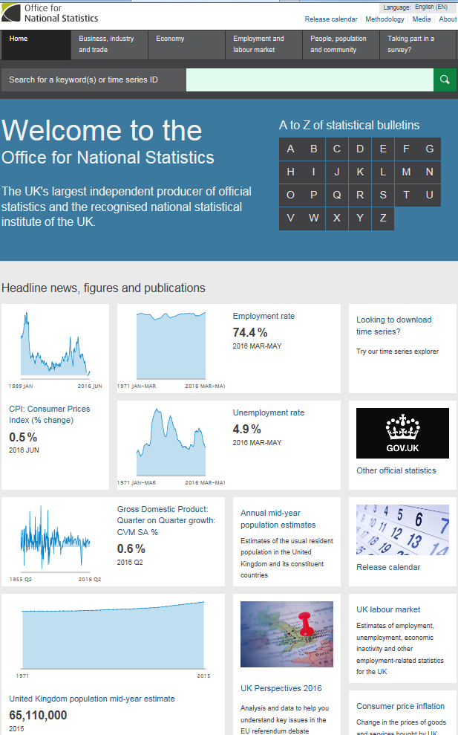
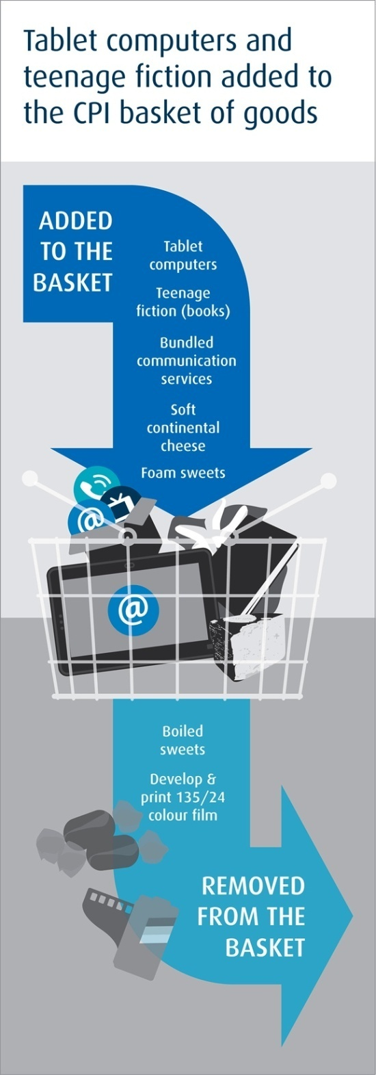
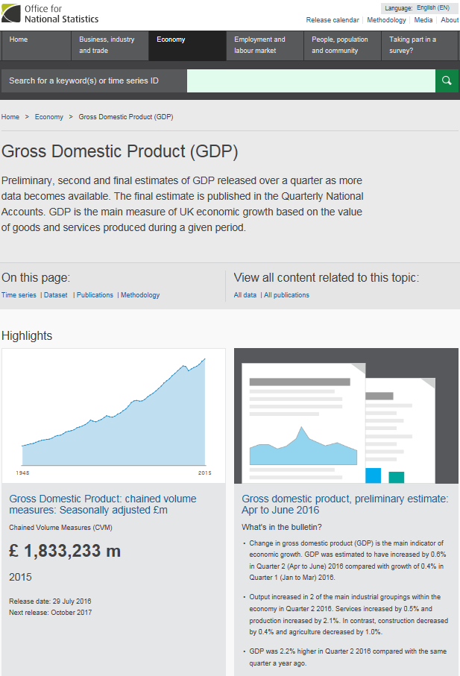
Imagine a world without this...

Slide 3
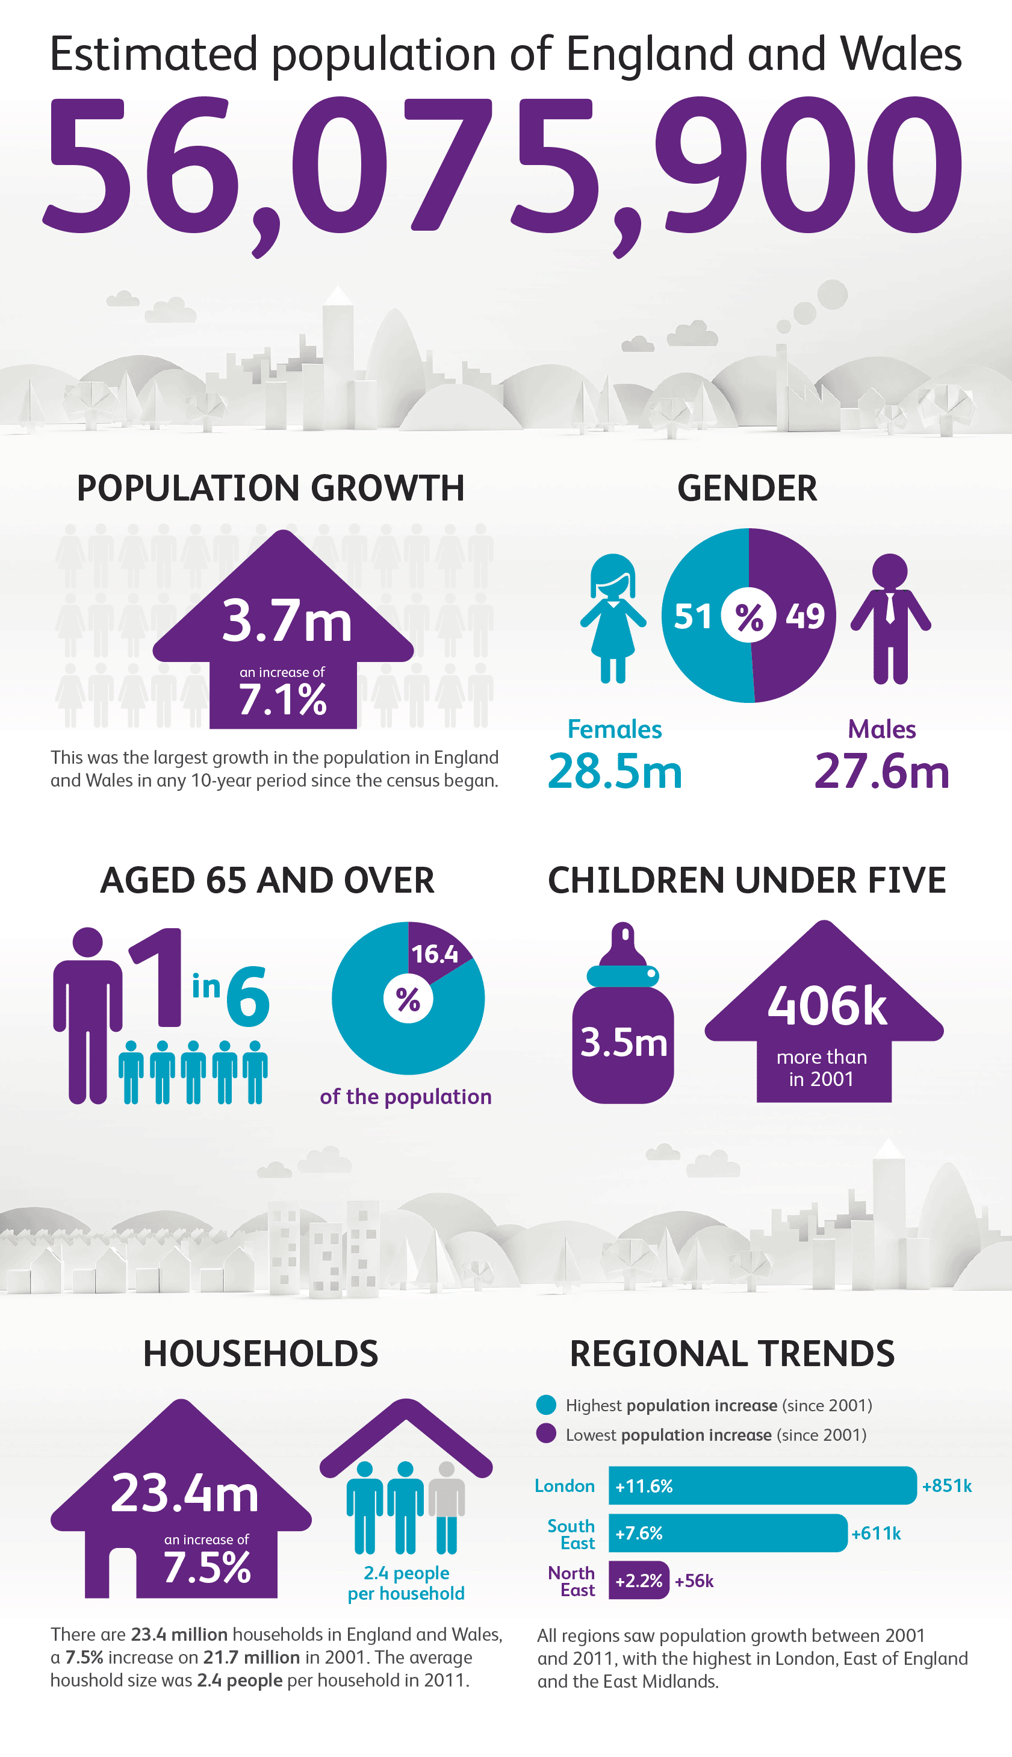
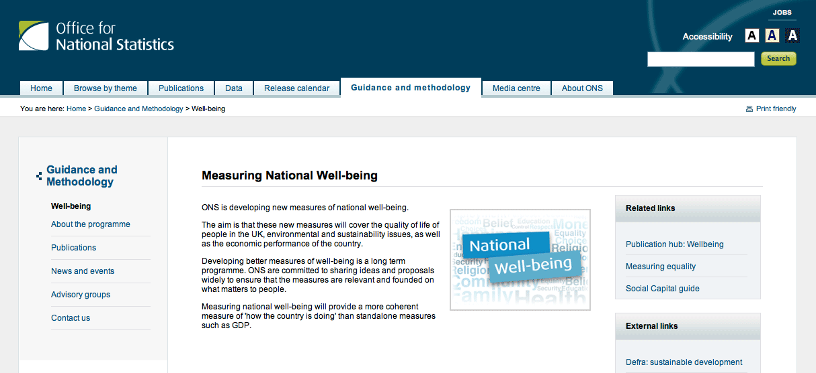
..or this

Slide 4
Our mission
High quality statistics, analysis and advice to help Britain make better decisions
Data is central to the decisions which affect our lives
Data is now available from previously unimaginable sources.
We treat personal data confidentially and make sense of numbers for the public good
Notes:
Official statistics are for the benefit of society and the economy generally. They allow the formulation of better public policy and the effective measurement of those policies; they inform the direction of economic and commercial activities; they provide valuable information for analysts, researchers, public and voluntary bodies; and they enable the public to hold to account all organisations that spend public money, thus informing democratic debate.

Slide 5
Statistics are used everyday

Slide 6
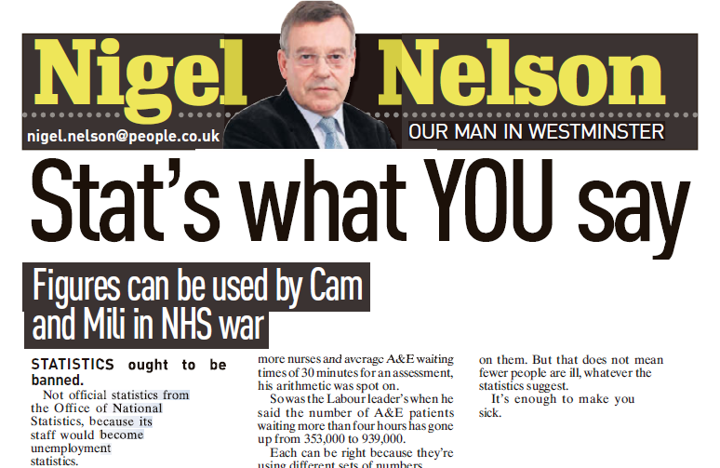
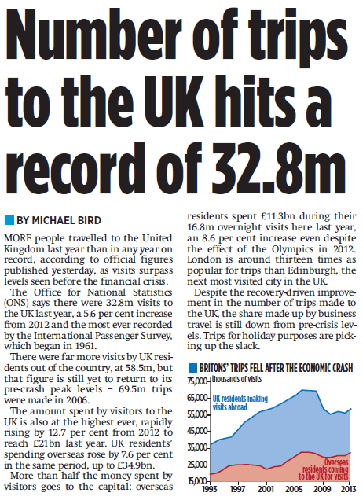
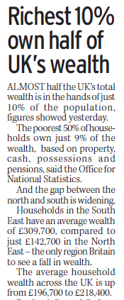
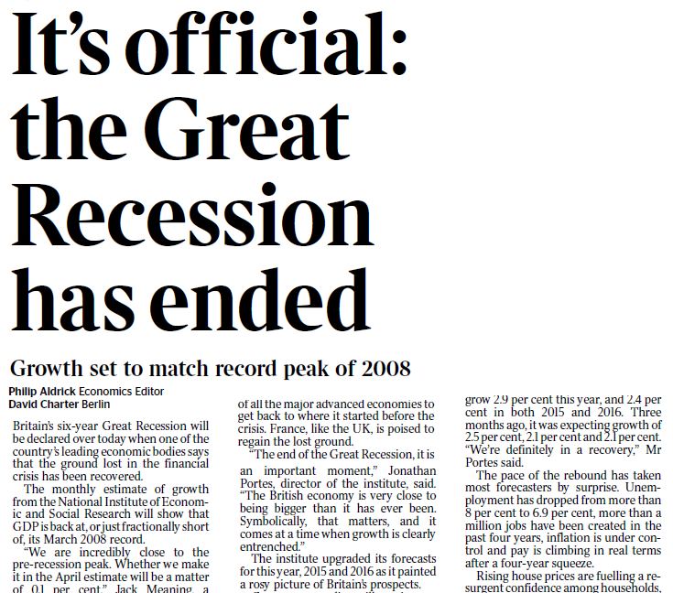
Just a normal day at the office...
Notes:
An average month...
700 to 800 pieces of print coverage in national press
+ Broadcast
+ Specialist
+ Local & regional
+ Online
And, crucially, < 2% of which is negative

Slide 7
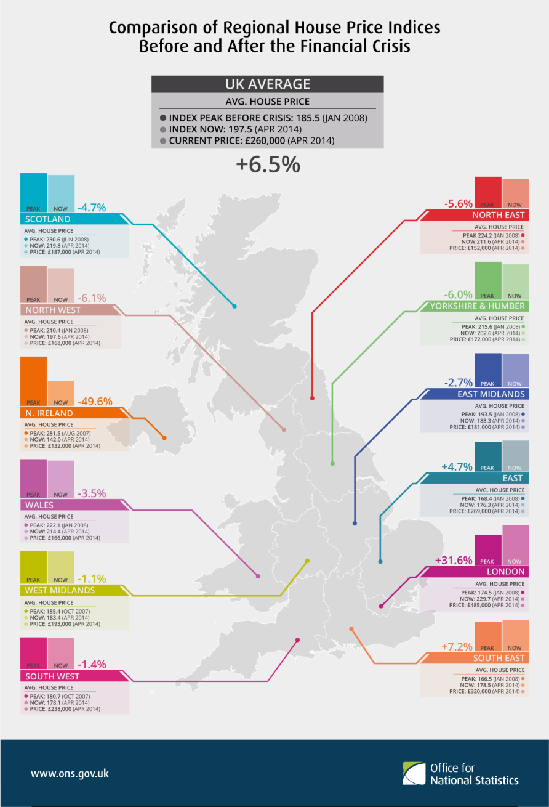
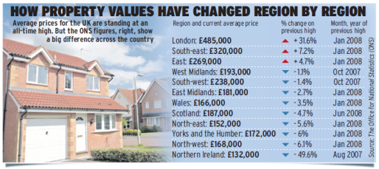
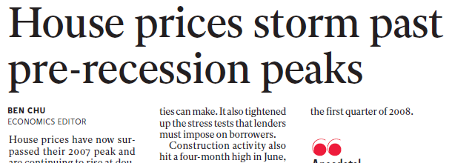
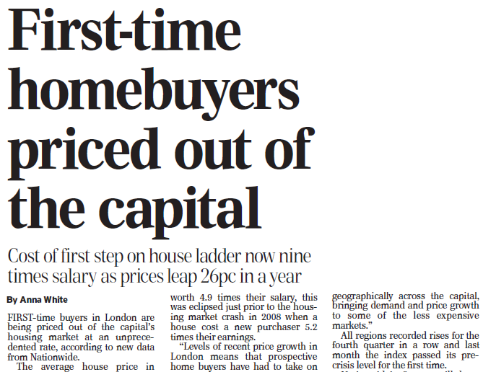
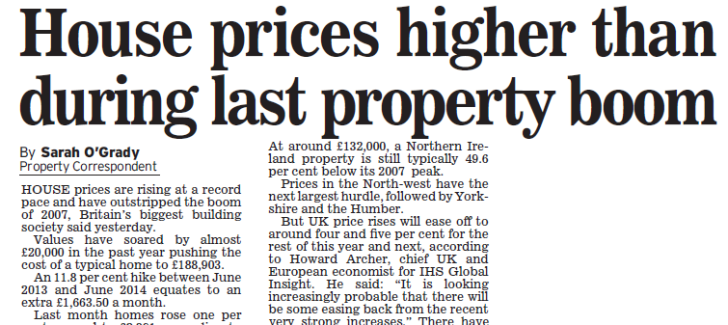
Innovative new products
200+ retweets
Over 2500 views in first 24hrs, making it the 4th most popular ONS webpage
Average user viewed for 99 seconds
Coverage in print and online editions

Slide 8
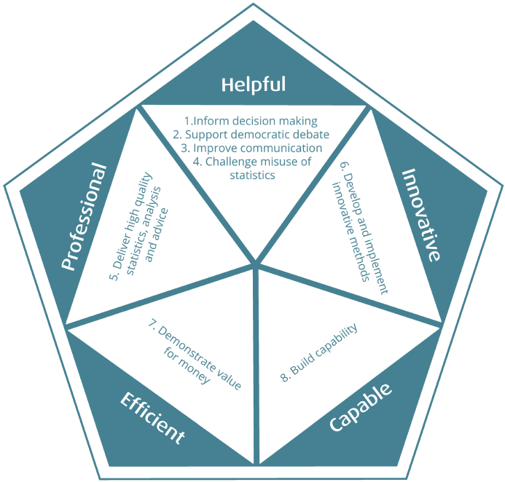
Making it happen
Helpful
Professional
Innovative
Efficient
Capable
Notes:
To achieve our mission, over the next five years we will focus on five perspectives. Together they describe the way we will work with others to provide a quality service, our ambition to be innovative, to deliver in a cost effective way and to ensure we optimise the capability of the statistical community. Building stronger relationships will enable us to be more helpful and intuitive in responding to the needs of our stakeholders.
They provide five tests of our success.
Helpful - The test of our success will be the ratings given to us by those who rely on our services.
Professional - The test of our success will be that our services, including our statistics, analysis and advice, are accepted and used with confidence. Equally, we will safeguard information relating to individuals and organisations in ways that they can trust.
Innovative - The test of our success will be the measurable benefits that we deliver from continuous improvement and a spirit of curiosity.
Efficient - The test of our success will be the improvement in performance and delivery which we achieve from better use of resources.
Capable - The test of our success will be that those involved in public policy are equipped with the necessary skills and tools to tackle the challenges set out in this strategy.

Slide 9
ONS – an introduction
Better statistics, better decisions
Peter Fullerton
Deputy Director
Data Science Campus

