Slide 1
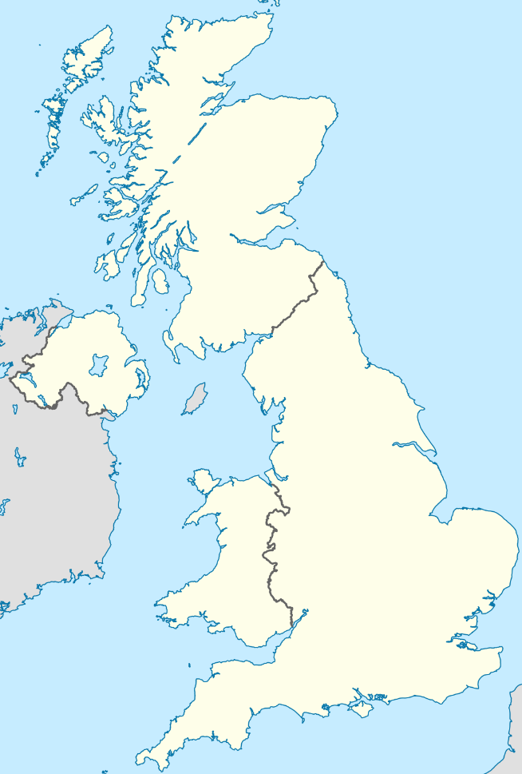
UK Collaborative Centre for Housing Evidence (CaCHE)
ESRC/AHRC/JRF (£6M over 5 years)
HM Land Registry
HMRC
Registers of Scotland
UK
Devolved Nations
Local Authorities
NISRA
ONS
NRS
DWP
Environment Agency
DCLG
StatsWales
statistics.gov.scot

