Slide 1
Land Value Tax
in London
Catherine Barnaby
C.Barnaby@bath.ac.uk
Bath IMI
Bath Institute for Policy Research (IPR)

Slide 2
Overview of talk
Current property taxes;
Land value tax – what it is;
Land value tax – how to estimate it;
Comparisons of LVT with current taxes.

Slide 3
Types of Property Tax (London)
Council Tax(CT): Private dwellings, based on property value (banded). Paid every year;
Stamp Duty Land Tax (SDLT): Based on sale value with marginal banding. Paid when property changes ownership.
London 2015. Domestic SDLT=£3.0bn, Non-Domestic SDLT=£1.3bn;
National Non-Domestic Rates (NNDR): Business properties. Property is given rateable value; rate payable is set centrally.
Other tax revenues - small in comparison.
(Annual tax on enveloped dwellings)

Slide 4
Land Value Tax, LVT (Denmark, New York…)
Land (not property) is given a value.
Tax payable is percentage of land value.
Why??? Reasons include:
Recovers value from society providing amenities, infrastructure (Crossrail, Roads, HS2) etc;
Encourages maximal use of land;
Lots of political studies, think-tank work, social commentaries…
But no numbers to go with them. What level would need to be set in the UK? Will it give the expected re-distribution of tax burden?
Can be based on rental value (called Land Rental Value Tax).

Slide 5
Estimating Land Value Tax (1)
Need a value for the land. Could use
property value – rebuild cost
Mirrors an implementation.
No real data in UK; time-consuming.
Estate Agents?
Land registry? Builders?
What is “similar”?
Insurance Companies? Builders?

Slide 6
Estimating Land Value Tax (2)
Or at a Borough level, use:
Typical land value per hectare;
Number of hectares occupied by property.
Lots of drawbacks: accuracy, timeliness….
But… sufficient for a first-estimate.
House of Commons Library
Generalised Land-use Database (GLUD)

Slide 7
Estimating Land Value Tax (3) Comparing to other taxes.
Keep total revenue constant.
Sets LVT percentage;
Calculate revenues;
Compare by Borough.
Dwellings – area of buildings, or building+garden?
Domestic LVT rate = Non-domestic LVT rate?
Plots: Order Boroughs by percentage increase in revenue.

Slide 8
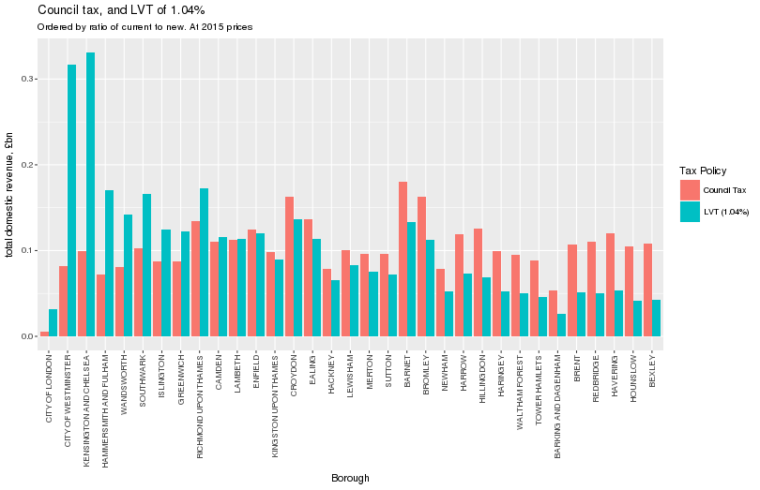
Results(1). Domestic LVT at 1.04%, CT

Slide 9
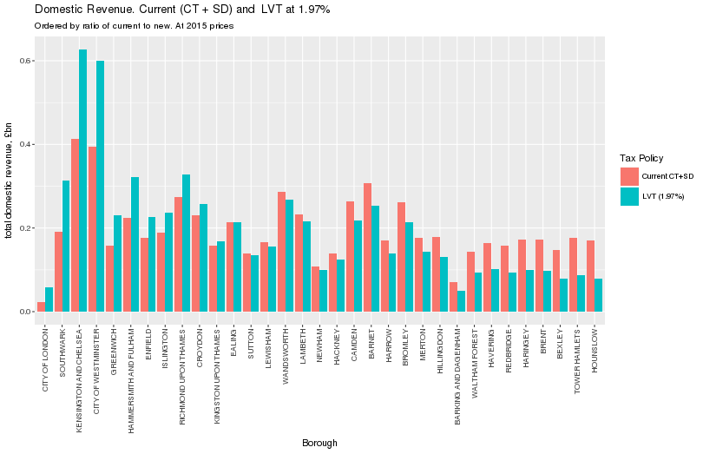
Results(2). Domestic LVT at 1.97%, CT+SD

Slide 10
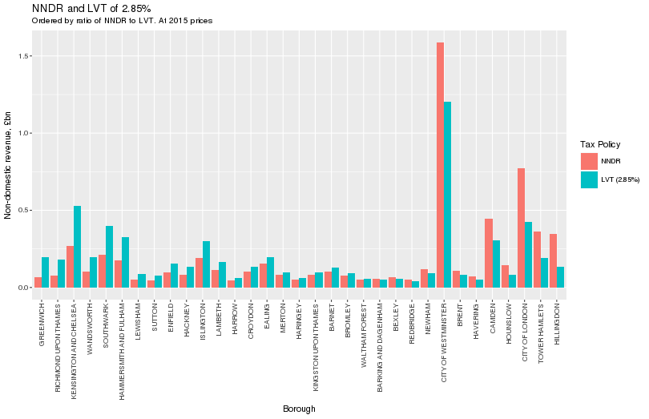
Results(3). Non-Domestic LVT at 2.85%, NNDR

Slide 11
Summary
First UK qualitative work on LVT;
Lots of caveats, but does what’s needed;
Base for lots of other work: within-Borough variation, Borough-boundaries, value of being close to…;
Shows Boroughs which win or lose compared to current taxes.
Simple and effective methodology;
Easily extends across UK;
Informed policy decisions

Slide 12
Thank-You
Questions?
Catherine Barnaby,
Bath IMI,
C.Barnaby@bath.ac.uk

