Slide 1
Alcohol Brief Interventions (1 hour Training Course)
Location ...........................
Date ...................................
Trainer.................................

Slide 2
To Increase .....
Understanding... the scope of alcohol harm and how brief interventions work
Knowledge... of alcohol definitions and the tools & techniques of brief interventions
Skill... To deliver and succeed
and importantly to increase
Confidence

Slide 4
UK Lower-risk Guideline GuidelineEngland
Risk | Men | Women
Lower risk | Both men and women should not regularly drink more than 14 units per week, spread over three or more days
Increasing risk | Regularly drinking 15-50 units per week | Regularly drinking 15-35 units per week
Higher risk | More than 8 units per day on a regular basis or more than 50 units per week | More than 6 units per day on a regular basis or more than 35 units per week

Slide 5
Our Future Drinkers
% 13-year –olds who have been drunk at least twice
HBSC 2009/10 Health Behaviour in School-aged Children- top 15
Health Behaviour in School-aged Children 2009/10

Slide 6
Health Harms

Slide 7
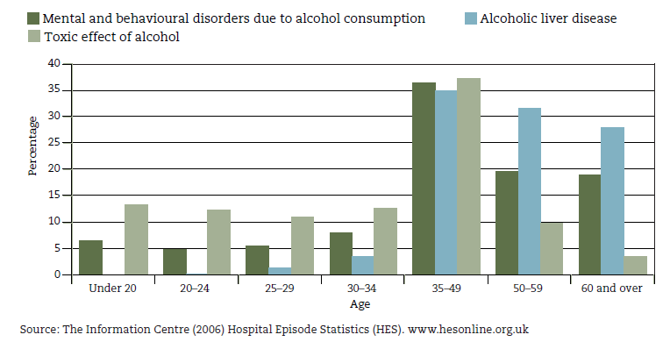
Tip of the Iceberg.......
Percentage of NHS admissions where there was a primary or secondary diagnosis of selected alcohol-related conditions by age

Slide 8
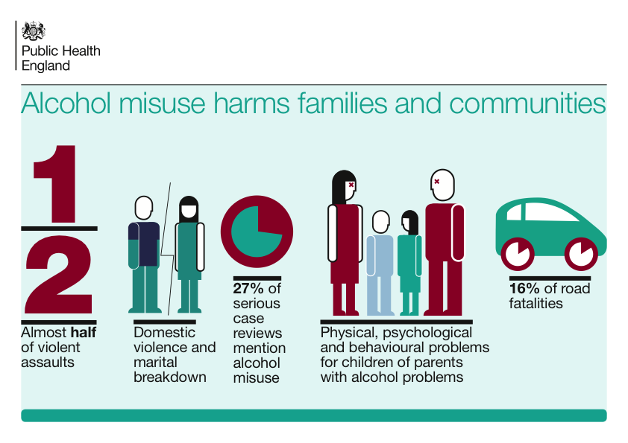
Social Harms from Alcohol

Slide 10
So who is at risk of alcohol related harm?
Potentially 10 million people in England
It’s not just the hard core cases
It doesn’t take much to be at risk
It’s about minimising the risk where possible

Slide 11
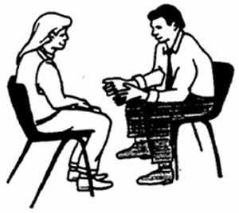
What we plan to cover
Why Alcohol? What are the issues?
What can you do about it?
How do you do it?
What to consider?
Discussion

Slide 12
What is an Alcohol Identification & Brief Advice (IBA)?
“A short, evidence-based, structured conversation about alcohol consumption with a client to motivate and support the individual to think about and/or plan a change in their drinking behaviour in order to reduce their consumption”
NHS Scotland (2009)

Slide 13
What’s the point of IBA?
The primary goal of an alcohol brief intervention (IBA) is to reduce harmful drinking through showing the client...
What the consequences of their drinking are likely to be
What the client can do about it
What help and support can be accessed

Slide 14
Alcohol Brief Intervention (ABI) Pathway
Notes:
You may already be doing this – there is a ‘subtle difference’ between asking whether someone drinks is not asking permission to raise the issue
This simple thing sets the collaborative tone for the next couple of minutes right at the start of this brief conversation
This helps the clients engage,
engenders their ownership of the issue and
reduces resistance
MI Principles - Always gain permission before giving advice
Communicate risk sensitively - Smoking, Alcohol, Obesity

Slide 15
Ways to raise the issue
Alcohol Brief Intervention (ABI) Pathway
Asking open questions will give you more information and
allow for conversation:-
“What has made you want to... Cut down?”
“It sounds like... you might be interested in changing...”
“You mentioned that…. You are drinking every night”
Or more direct
“How do you feel about how much you drink?”
“What do you like about…”
“What do you dislike…”
“So how much do you spend on alcohol?”
Notes:
Presenter’s notes (25 minutes for slides 15-30):
Starting a conversation about healthy lifestyles can be daunting for some.
The main part is to listen to what the other person is saying and wait for them to raise the issue. That way they are showing they might be interested in talking about it.
For example they may say that they have decided that for a new year’s resolution they will eat more healthy.
At this point you could respond by saying “What has made you want to eat healthily?”.
You could say “I recently did this course and they said there’s lots of information on eating healthily on the Change4Life website and the Cardiff Healthy Cities website”.
Other examples from Smoking Brief Intervention
What is it you like about your smoking?
Do you always plan on being a smoker?
What would need to happen for you to stop smoking?
What would it take for you to quit smoking?
Who else have you spoken to about your smoking?
So how much are you spending on cigarettes these days?
indirect questions to start with.
E.g. Do you have any concerns about……
Have you thought about…..
How do you feel…..
What do you think…..
Are you aware of risks….
• Or more directly
Do you know……..
Tell me about……..

Slide 16
Providing Advice
Alcohol Brief Intervention (ABI) Pathway
Advice giving from professionals is important but how it is “given” is even more crucial
Ask
What do you think about how your drinking is affecting your health?
What do you already know about drinking and health?
Would you like more information about....?

Slide 17
Effective conversations include...
Alcohol Brief Intervention (ABI) Pathway
Expressing empathy
Empathy is not sympathy, pity, warmth, acceptance or identification.
Empathy is showing an active interest in and effort to see the world through their eyes
Explore opinions and ideas about the behaviour
Accurate reflection
Listening well and reflecting back what you’ve heard helps to clarify information and leads to greater exploration.
“So what you’re saying is...”
“Can I just check...”
Notes:
Notes for reference
Empathy is not sympathy, a feeling of pity or camaraderie with the person. Neither is it identification: “I've been there and I know what you’re experiencing. Let me tell you my story”. Empathy is not warmth, acceptance, genuineness or client advocacy.
Empathy is an active interest in and effort to understand the other’s internal perspective, to see the world through their eyes. “put self in clients shoes”
Clinicians high in empathy are curious, approach the session as an opportunity to learn about the client. Explore the clients opinions and ideas about the behaviour.
The clinician makes active effort to understand the client point of view, shows interest, offers accurate reflections of what the client has said

Slide 18
Alcohol Brief Intervention (ABI) Pathway
Shaping and Agreeing Goals
Capitalise and build on the persons suggestions for change
Agree with them what they will do
Include referral to services if
appropriate
Follow up; telling them you are interested in finding out how they got on and can support their behaviour change

Slide 19
Alcohol Brief Intervention (ABI) Pathway
Raise the issue or look/ listen for ‘Triggers’
Exit strategy – remember that you or the client can stop the conversation at any time
Close the conversation but keep an ‘open door’ and sign post or refer onto further support
Screen and give feedback
Listen for readiness to change
Use a suitable approach
Build Confidence
Coping Strategies
Info and advice
Menu of Options
Motivate

Slide 20
Opportunities for change
Social issues
Relationship problems and domestic violence.
Criminal behaviour (e.g. driving offences, breach of the peace, shoplifting).
Unsafe sex/sexual risk taking.
Personal risk taking.
Financial problems.
Bereavement (which can lead to use of alcohol as a coping strategy).
Effects on physical health
Accidents/injuries.
Gastrointestinal system, including dyspepsia (indigestion), gastritis and pancreatitis.
Various liver abnormalities.
Cardiovascular system, including cardiac arrhythmias, hypertension and stroke.
Reproductive system problems and unexplained infertility.
Cancers of the mouth, pharynx, larynx, oesophagus, breast and colon.
Other effects, including seizures, gout and eczema.
Effects on mental health
Anxiety and panic disorders.
Depressive illness.
Amnesia, memory disorders and dementia.
Treatment resistance in other psychiatric illnesses and as a factor in relapse.
Self-harm.
Occupational effects
Repeated absenteeism, especially around weekends.
Impaired work performance and accidents.
Employment difficulties.

Slide 21
Alcohol Screening
What is it?
…it is a method of identifying alcohol consumption at a level sufficiently high enough to cause concern.

Slide 22
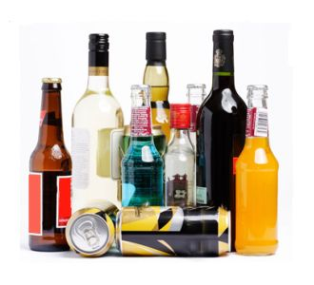

Slide 23
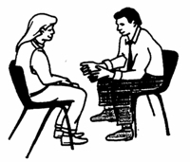
The AUDIT-C Score (0-12)
If time, carry out full AUDIT
0
1
2
3
4
5
6
7
8
9
10
11
12
Non Drinker
Sensible Drinking
Lower Risk
Hazardous Drinking
Increasing Risk
Harmful Drinking
Higher Risk
Potentially
Addicted / Dependant
Public Health Wales Alcohol Brief Interventions Train the Trainer Course

Slide 24
Always be on the look out for
A naturally occurring life transition or health event that motivate or activate individuals to spontaneously adopt risk-reducing health behaviours.
Timing formal interventions to take advantage of these naturally occurring events increase the effectiveness of that behaviour change.

Slide 25
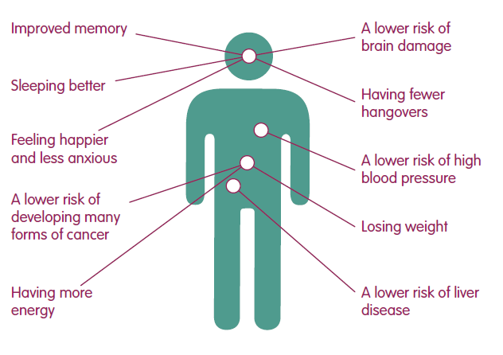
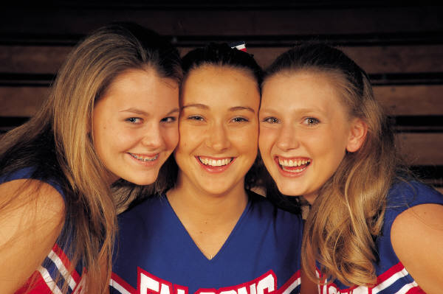
Advice
Health Advice
Feel better in the mornings
More energy!
Improved skin
Fitter, faster
Weight control

Slide 26
Benefits
Psychological, Social and Financial Benefits
Lower risk of accident or injury
Less chance of getting into fights
Developing better relationships
Improved Self esteem
More time
More money
Seen in a different light at work

Slide 27
Menu of Options
“Swap your usual for...
A smaller drink
A lower strength drink
A soft drink
A later drink
A meal time only drink”
“Drink to relax? Try...
Exercise
Pamper time
Music, movies, books
Use the money saved to do something new”

Slide 28
Menu of Options
Tips for a Night Out
Make a plan – set yourself pre-night out limits
Set a budget – only take a set amount of cash out with you
Start later – but don’t start at home
Take your time – don’t get in rounds
Sit one out – have a soft drink when its your round
Stay hydrated – have a few glasses of water through the night

Slide 29
Points to Remember
Use a non-confrontational manner
Do not use if the client is intoxicated
Tell the client what you are doing and why
Discuss confidentiality
Acknowledge a low score (positive reinforcement)

Slide 30
Any Questions? Drop us an email
Craig Jones
Senior Health Promotion Practitioner
craig.jones@wales.nhs.uk
Carol Foster
Public Health Practitioner
carol.foster@wales.nhs.uk
Follow us on
Twitter @haveawordUK www.facebook.com/haveawordcampaign Website www.haveaword.org
Rhiannon Hobbs
Senior Public Health Practitioner
rhiannon.hobbs@wales.nhs.uk

