Slide 1
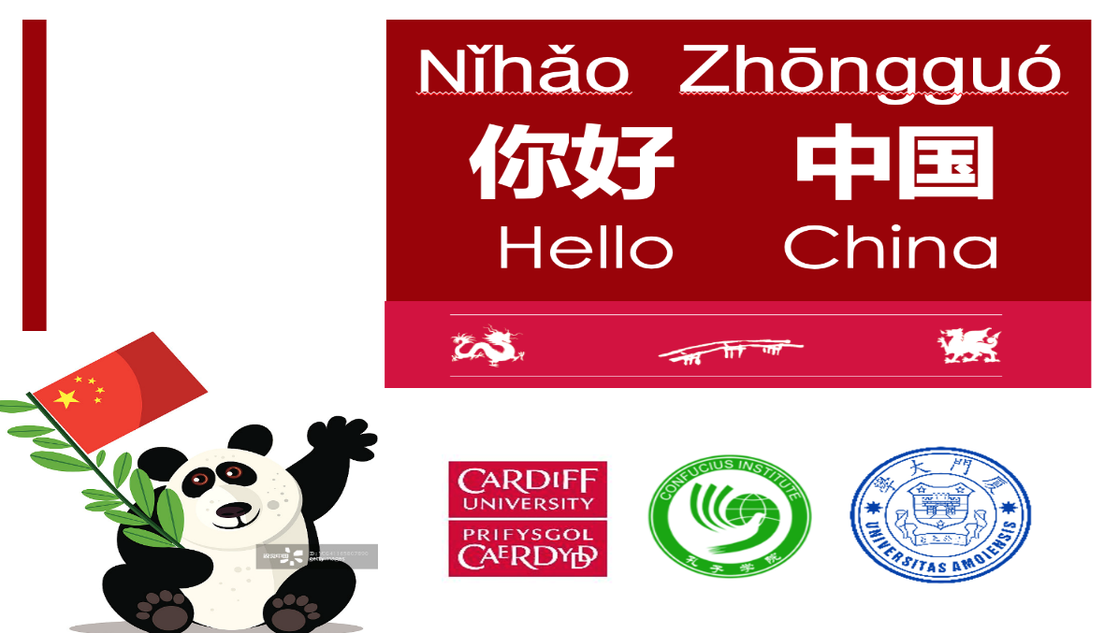



Nǐhǎo Zhōnɡɡuó
你好 中国
Hello China

Slide 2

PPT模板下载：www.1ppt.com/moban/ 行业PPT模板：www.1ppt.com/hangye/
节日PPT模板：www.1ppt.com/jieri/ PPT素材下载：www.1ppt.com/sucai/
PPT背景图片：www.1ppt.com/beijing/ PPT图表下载：www.1ppt.com/tubiao/
优秀PPT下载：www.1ppt.com/xiazai/ PPT教程： www.1ppt.com/powerpoint/
Word教程： www.1ppt.com/word/ Excel教程：www.1ppt.com/excel/
资料下载：www.1ppt.com/ziliao/ PPT课件下载：www.1ppt.com/kejian/
范文下载：www.1ppt.com/fanwen/ 试卷下载：www.1ppt.com/shiti/
教案下载：www.1ppt.com/jiaoan/

Slide 3




端午节
shíjiān
时间
yóulái
由来
xísú
习俗
When
Why
What

Slide 4

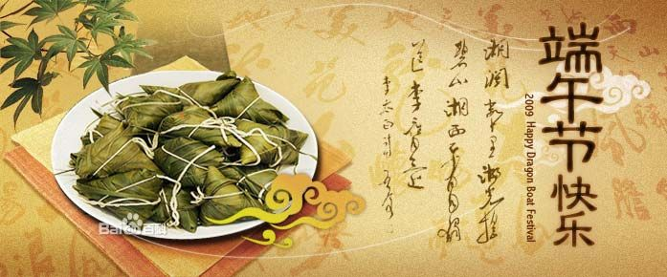

when
On 5th May in Chinese Lunar Calendar

Slide 5


Why
to commemorate a patriotic poet
Qūyuán 屈原

Slide 6
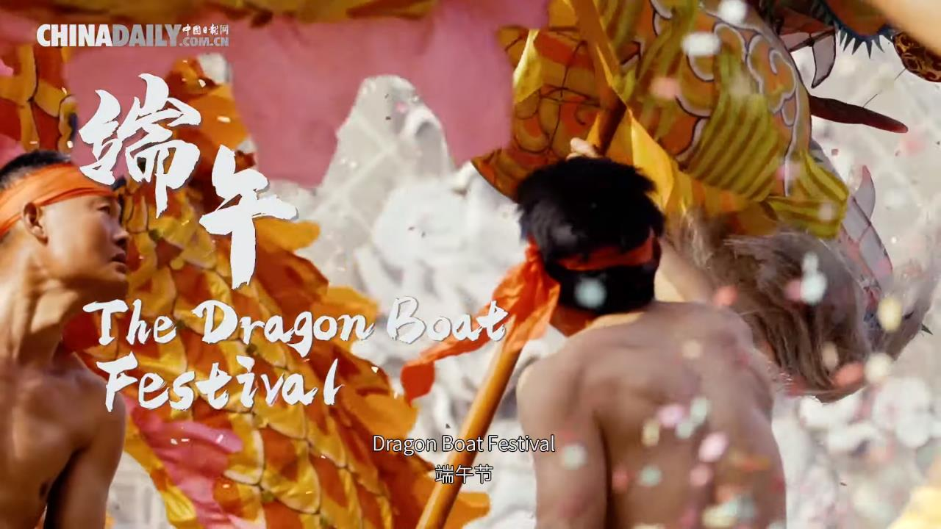
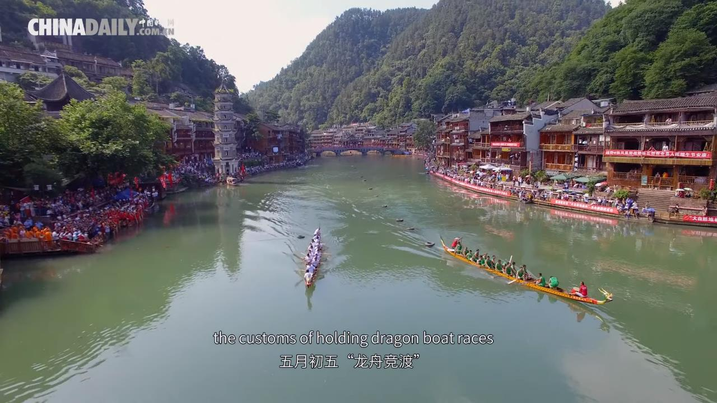
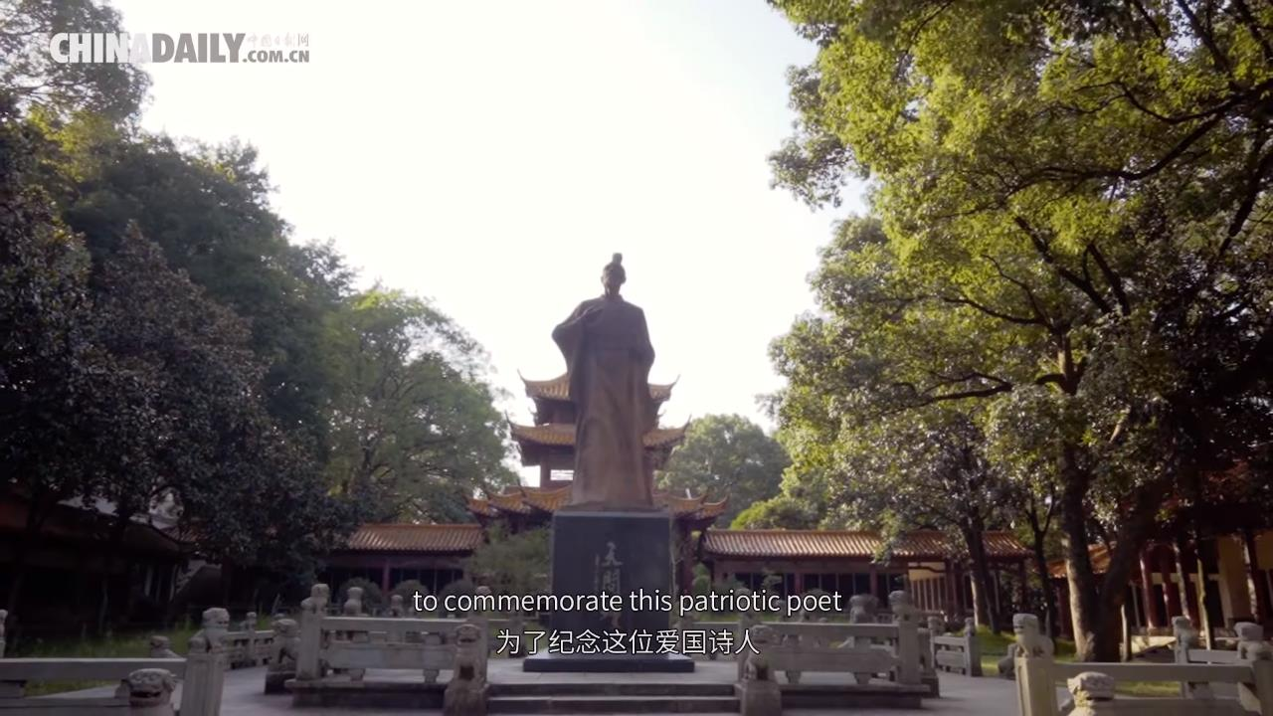
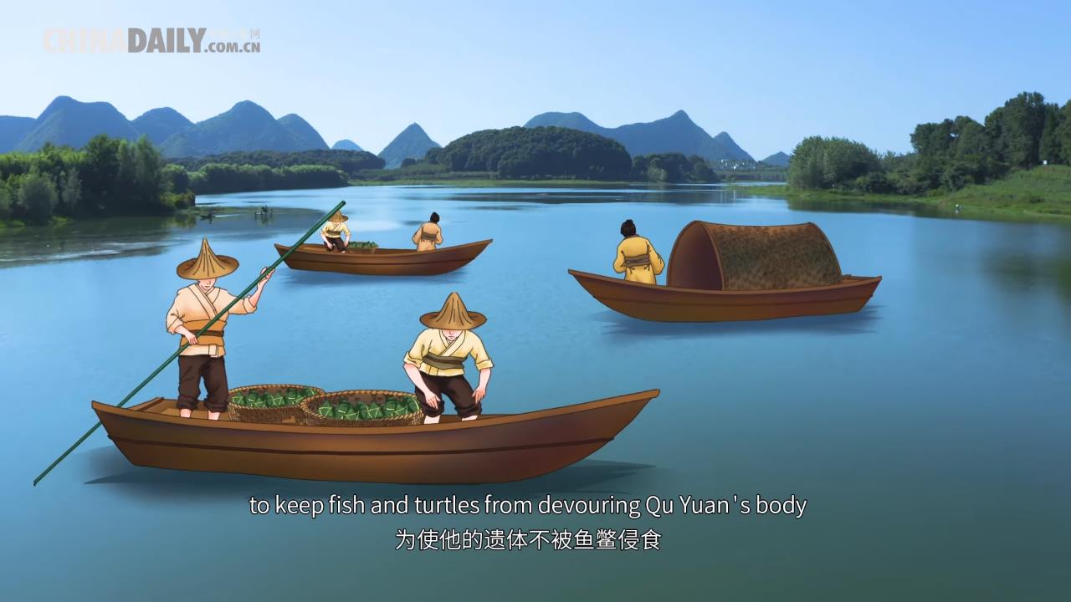
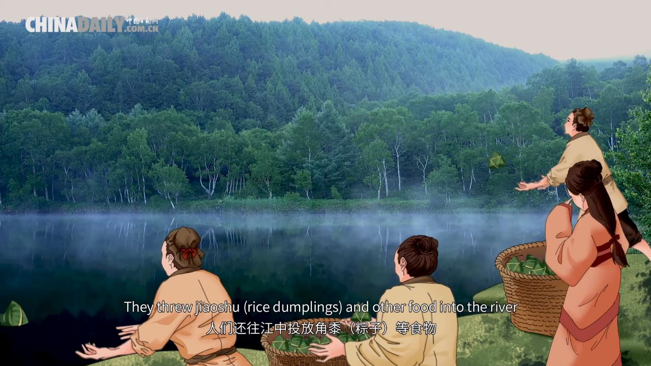
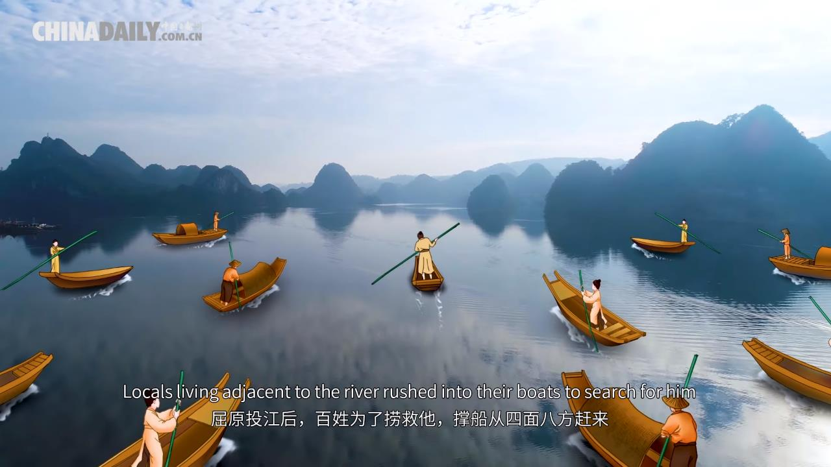
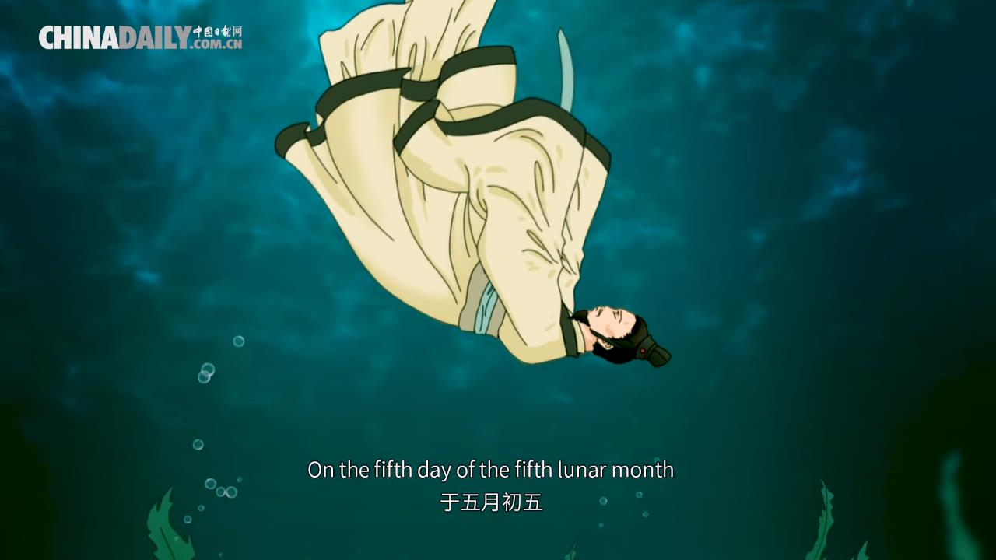
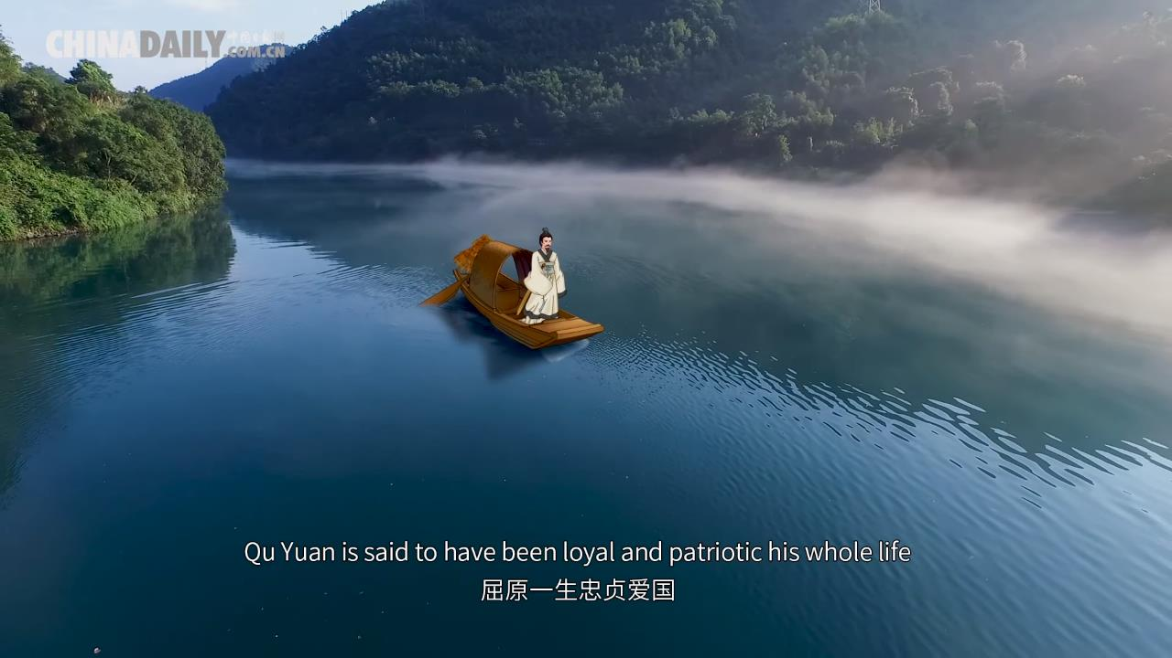
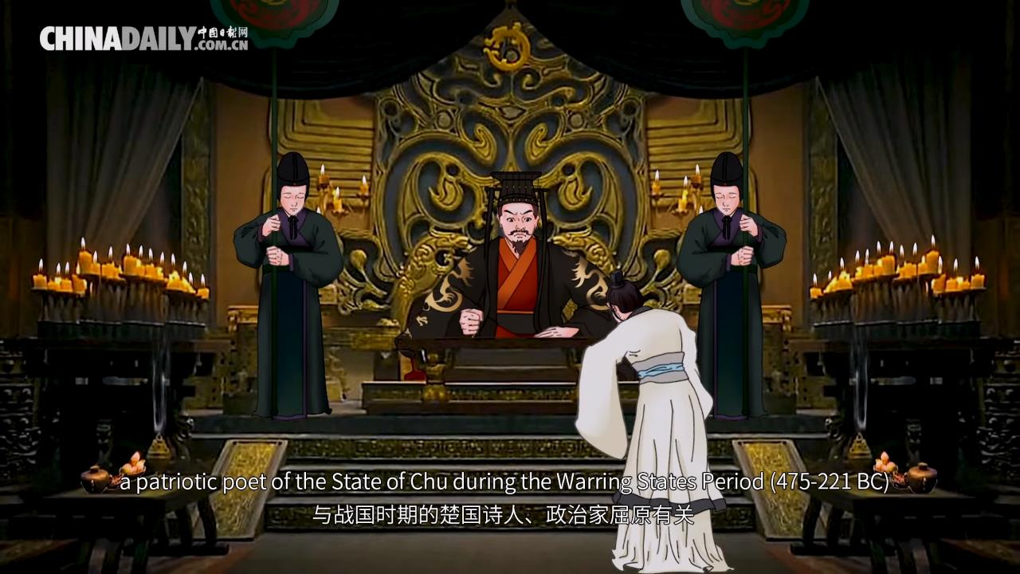
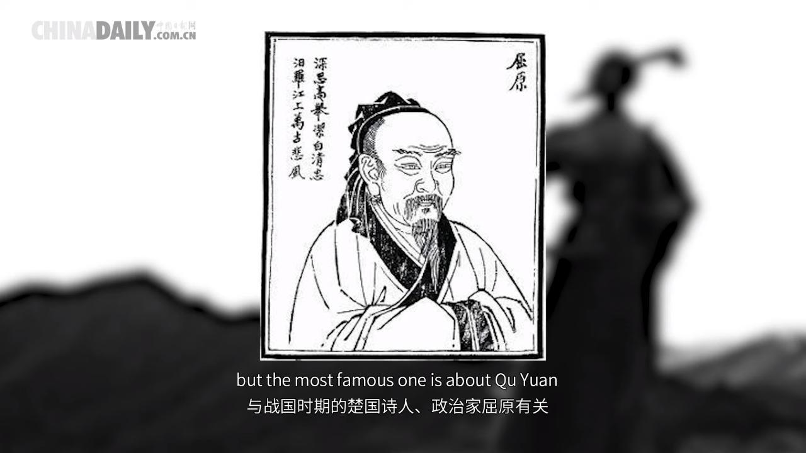

Slide 16
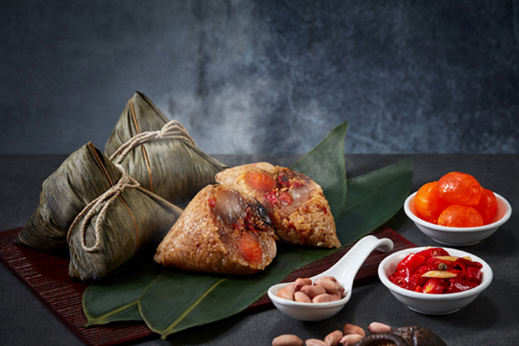
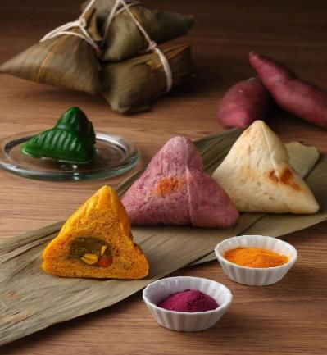
What
zònɡzi
粽子
1.eat sticky rice dumplings

Slide 17
What
2. have dragon boat race

Slide 18
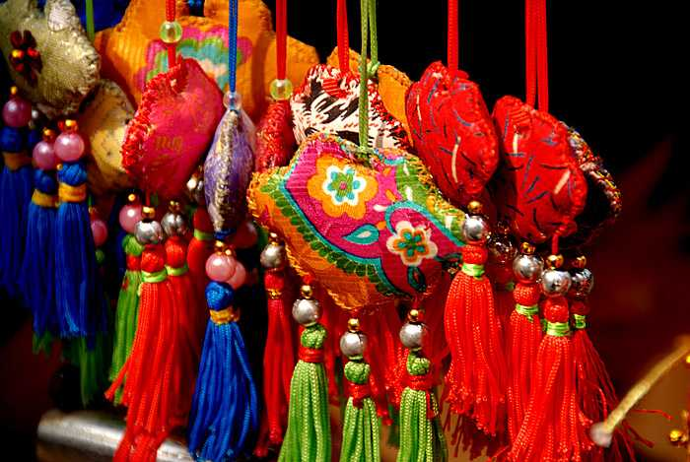
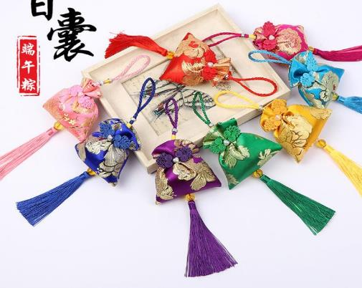
What
xiānɡnánɡ
香囊
3.wear perfume satchets

Slide 19
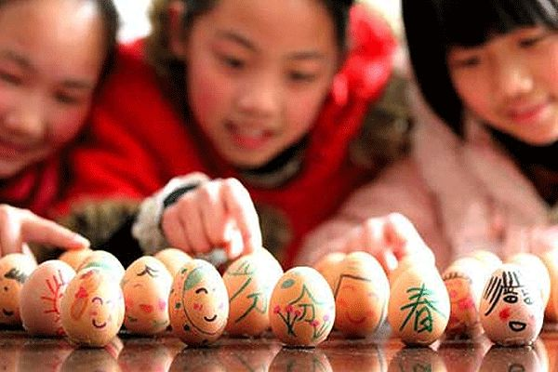
What
4. balance an egg

Slide 20
Q：When is the dragon boat festival in Chinese lunar calendar？
A: 15th August
B: 5th May
C: 5th June
☑

Slide 21
Q：Why do Chinese people have dragon boat festival？
A: just for fun
B: to commemorate a poet
C: to commemorate a emperor
☑

Slide 22
Q：What do Chinese people do on dragon boat festival？pick 3
A: eat dumpling
B: dragon boat race
C: wear a perfume satchet
D：balance an egg
☑
☑
☑

Slide 23
Q：What do Chinese people eat on dragon boat festival？
A: sticky rice dumpling (zongzi)
B: dumpling
C: egg
☑

Slide 24
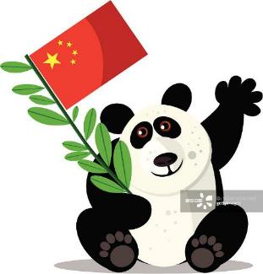



xièxie
谢谢
thank you
zàijiàn
再见
goodbye
*Pictures are from Google Images; Videos are from YouTube.
Cardiff Confucius Institute
Communicating Chinese language and culture in Wales
www.cardiff.ac.uk/confucius-institute

