Slide 1


ONS Data Science Campus
Peter Fullerton, Deputy Director
June, 2017
SYG Campws Gwyddor Data
Peter Fullerton, Is Gyfarwyddwr
Mehefin, 2017
ONS Data Science Campus, Phase 0.5, August 2016

Slide 2

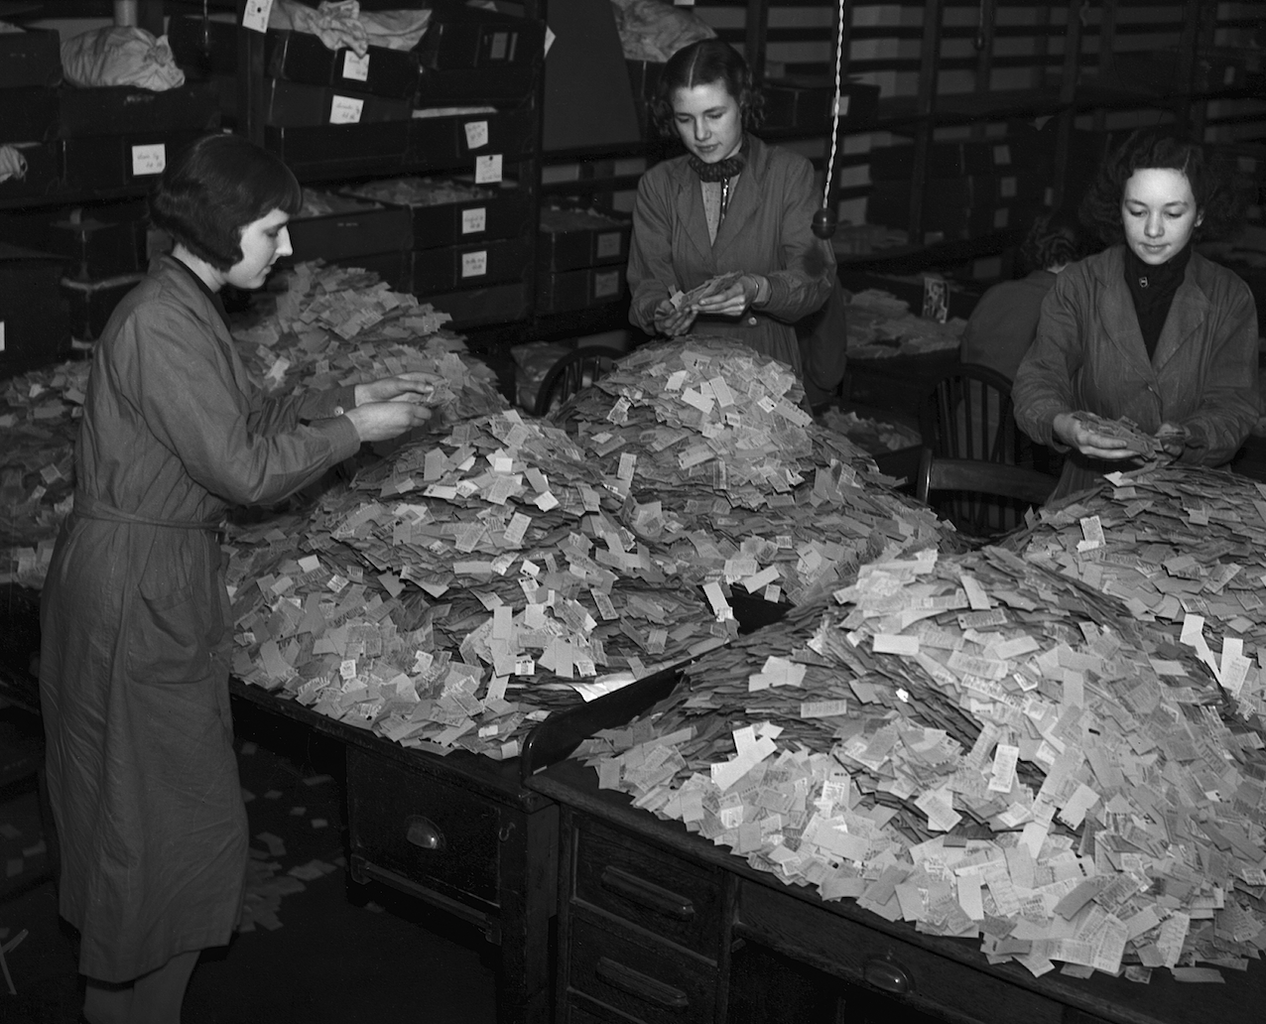
“Although better use of [data] has the potential to transform the provision of economic statistics, ONS will need to build up its capability to handle such data.
This will take some time and will require not only recruitment of a cadre of data scientists but also active learning and experimentation.
That can be facilitated through collaboration with relevant partners – in academia, the private and public sectors, and internationally.”
Independent Review of Economic Statistics
Professor Sir Charles Bean, March 2016, p.11
London Transport workers manually examine over 4 million tickets to identify most and least popular routes, March 1939
Gerry Cranham/Fox Photos/Hulton Archive/Getty Images

Slide 3
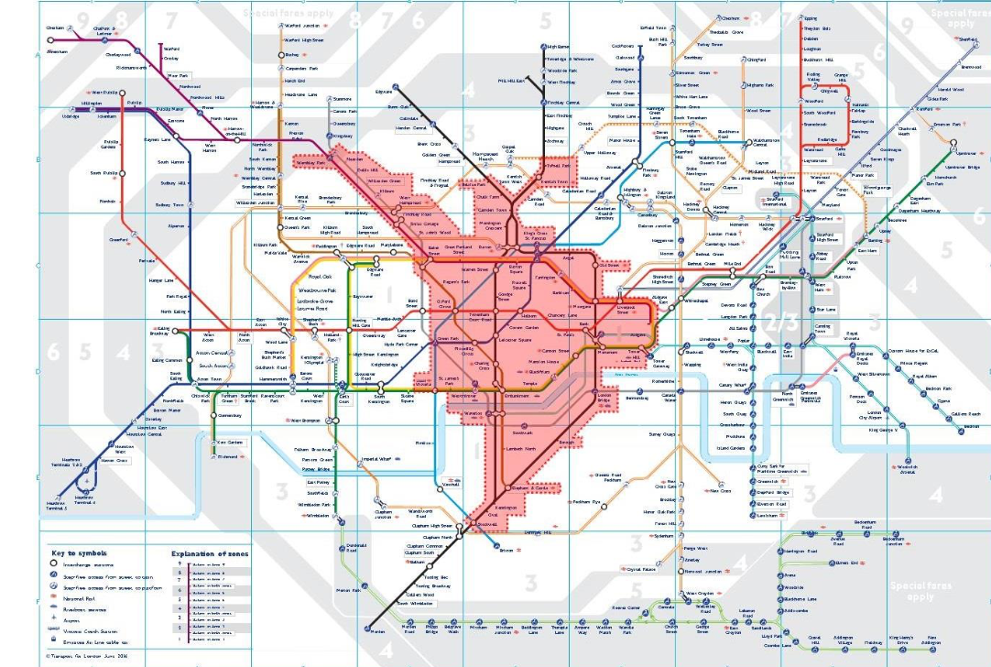
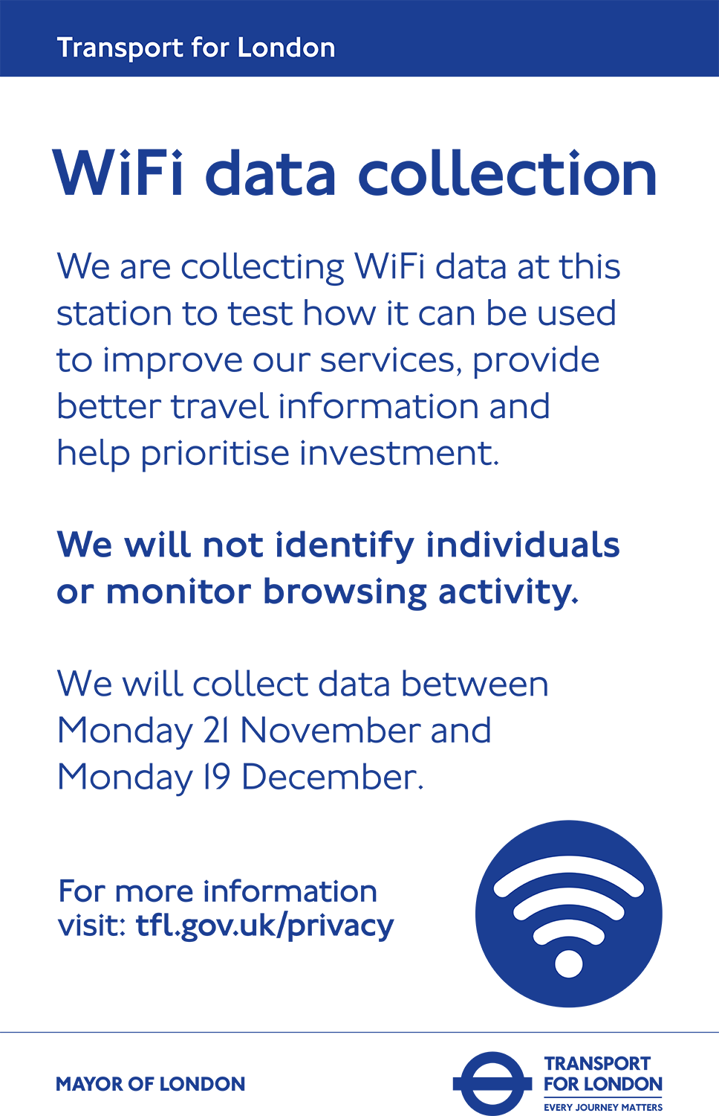
“The 21st Century has brought new challenges in the analysis of data, and it is increasingly apparent that solutions to these are both statistical and computational. This has led to a great demand for people both in industry and in research who are able to draw upon the mathematics of both computation and probability to make sense of the large amounts of data that are collected in order to solve major problems.
Data science is an interdisciplinary response to this demand”
- University of Warwick
Transport for London 2016 pilot, assessing journeys by WiFi access

Slide 4
“Our goal is to explore how sources such as administrative data and social data, and techniques such as machine learning and natural language parsing, can improve our understanding of the UK’s economy, communities and people.”
- Tom Smith, MD Data Science Campus
Computer science
Maths & statistics
Machine learning
Data science
Danger zone!
Traditional research
Domain expertise
The Data Science Venn Diagram, modified from Drew Conway

Slide 5
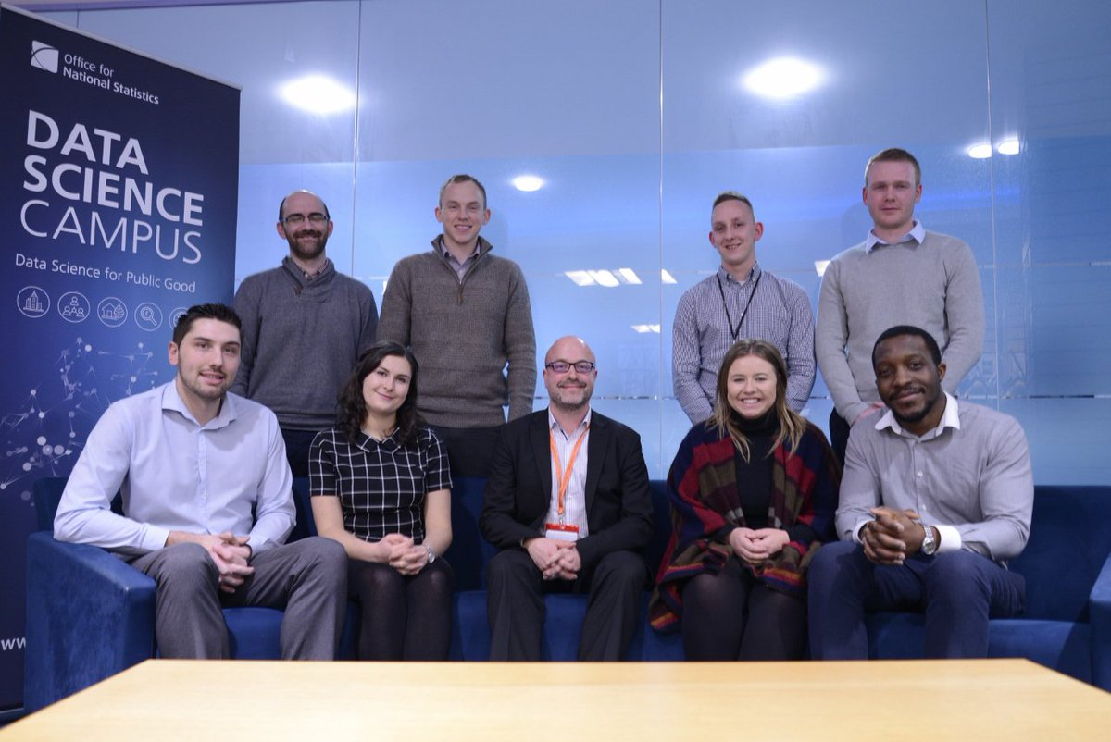
Growing Data Science Skills
Apprenticeship in Data Analytics
Developed with ONS Learning Academy
Two-year vocational programme
130 applications, 8 apprentices Dec 2016
150 applications in Round 2, Newport and Welsh Government
MSc Data Analytics for Government
Developed with ONS Learning Academy and GSS Professional Support
Dedicated Data Science pathway
Multiple Academic partners
First intake in September 2017
Data Science Accelerator
Government Data Science Partnership with GDS and GO-Science
3-month programme
Open to all Public Sector staff
Wales / South-West Hub @ Data Science Campus
First Cohort of Data Analytics Apprentices with Tom Smith, MD Data Science Campus, Dec 2016

Slide 6
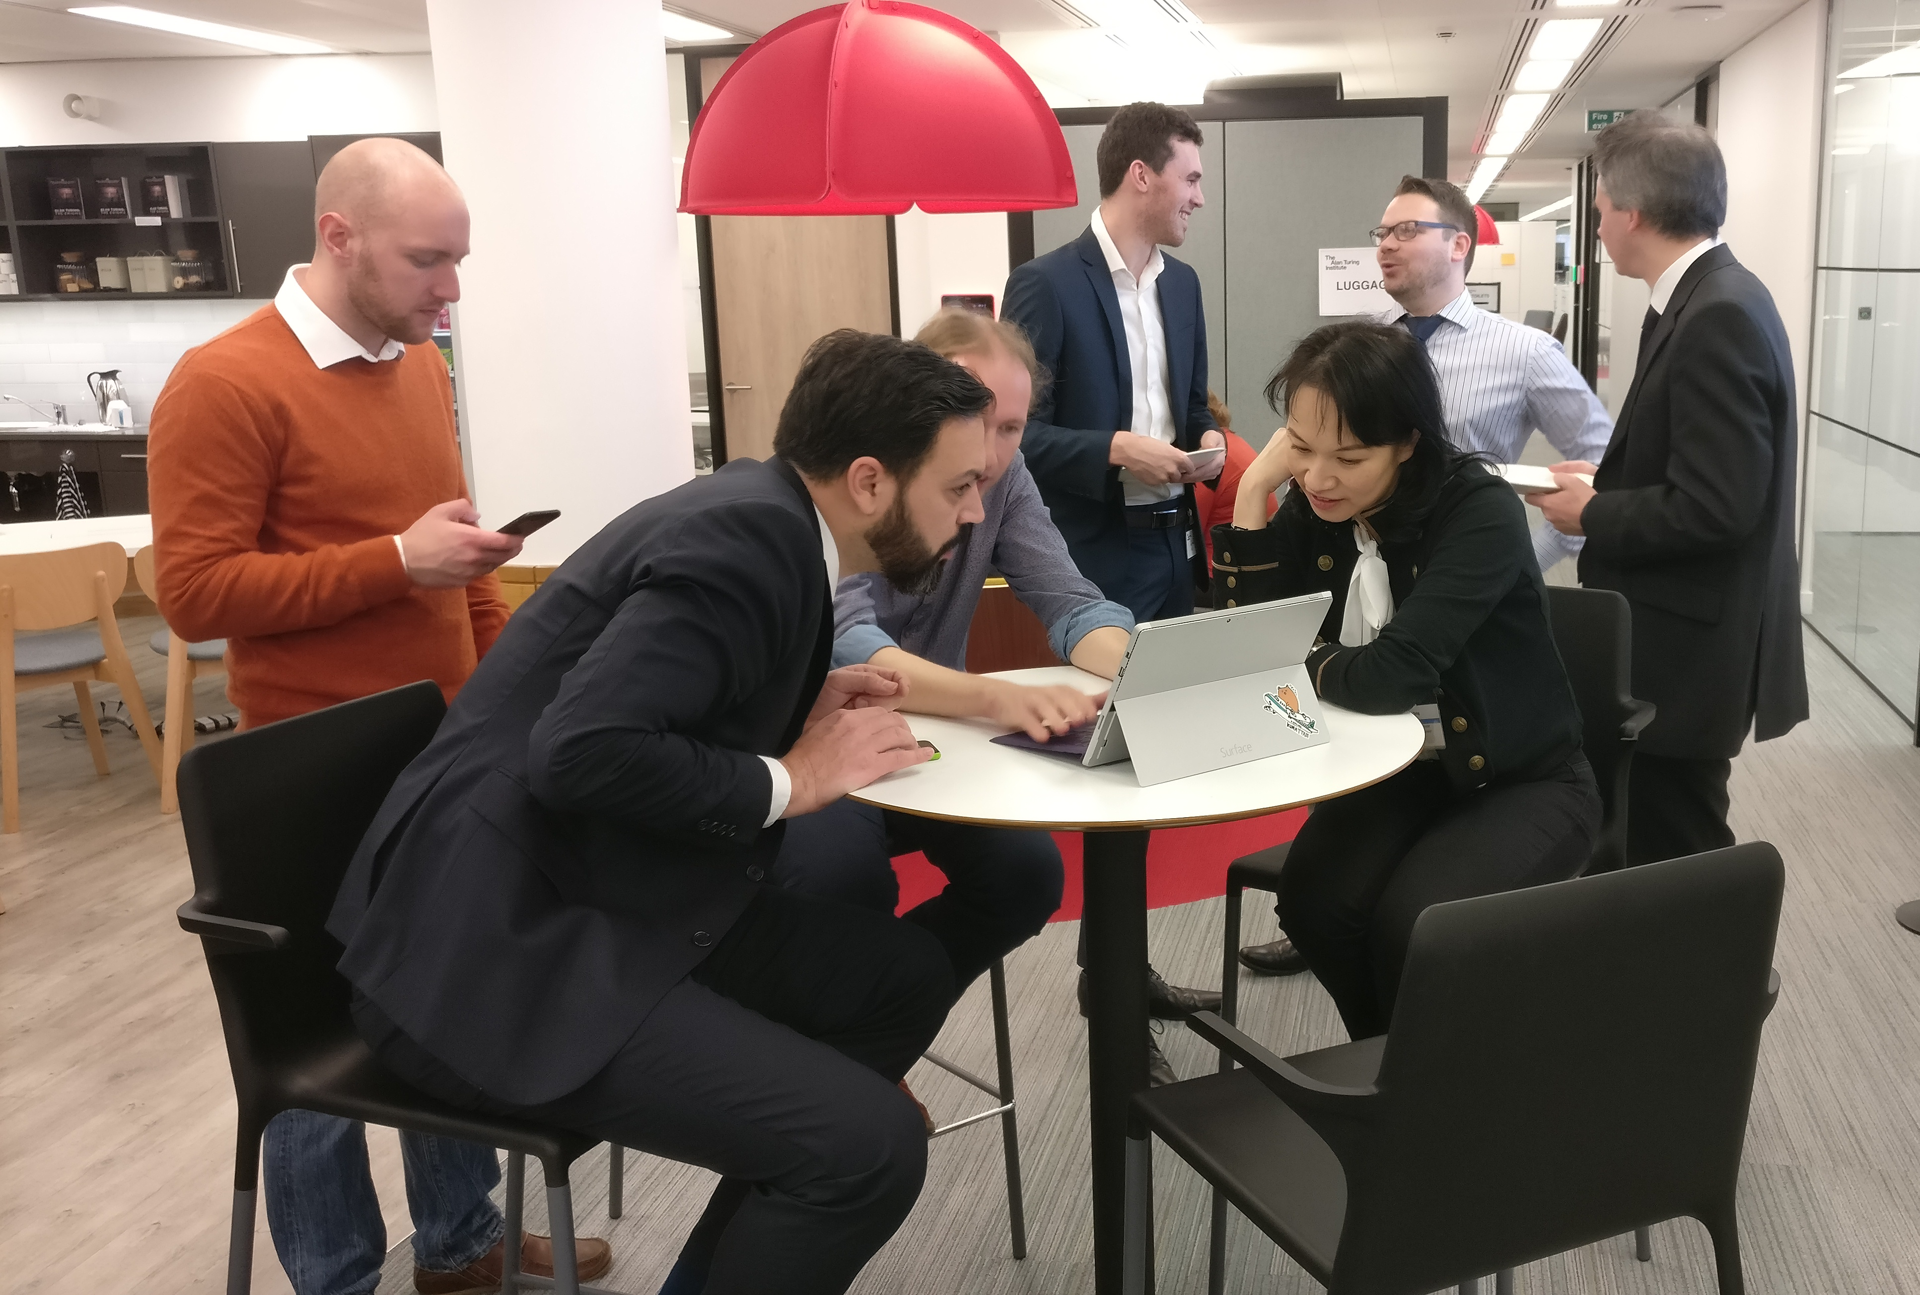
Data Science for Public Good
Research activities started in September 2016 under five core themes:
  Economic Statistics
  The Evolving Economy
  UK in a Global Context
  Social Data
  Urban and Rural
  Society
  Sustainable Development Goals
  Sustainability
8 research projects are underway and two rapid prototyping data dissemination tools have been built for partners
Data Science Campus data scientists collaborating with colleagues at the Alan Turing Institute, Jan 2017

Slide 7
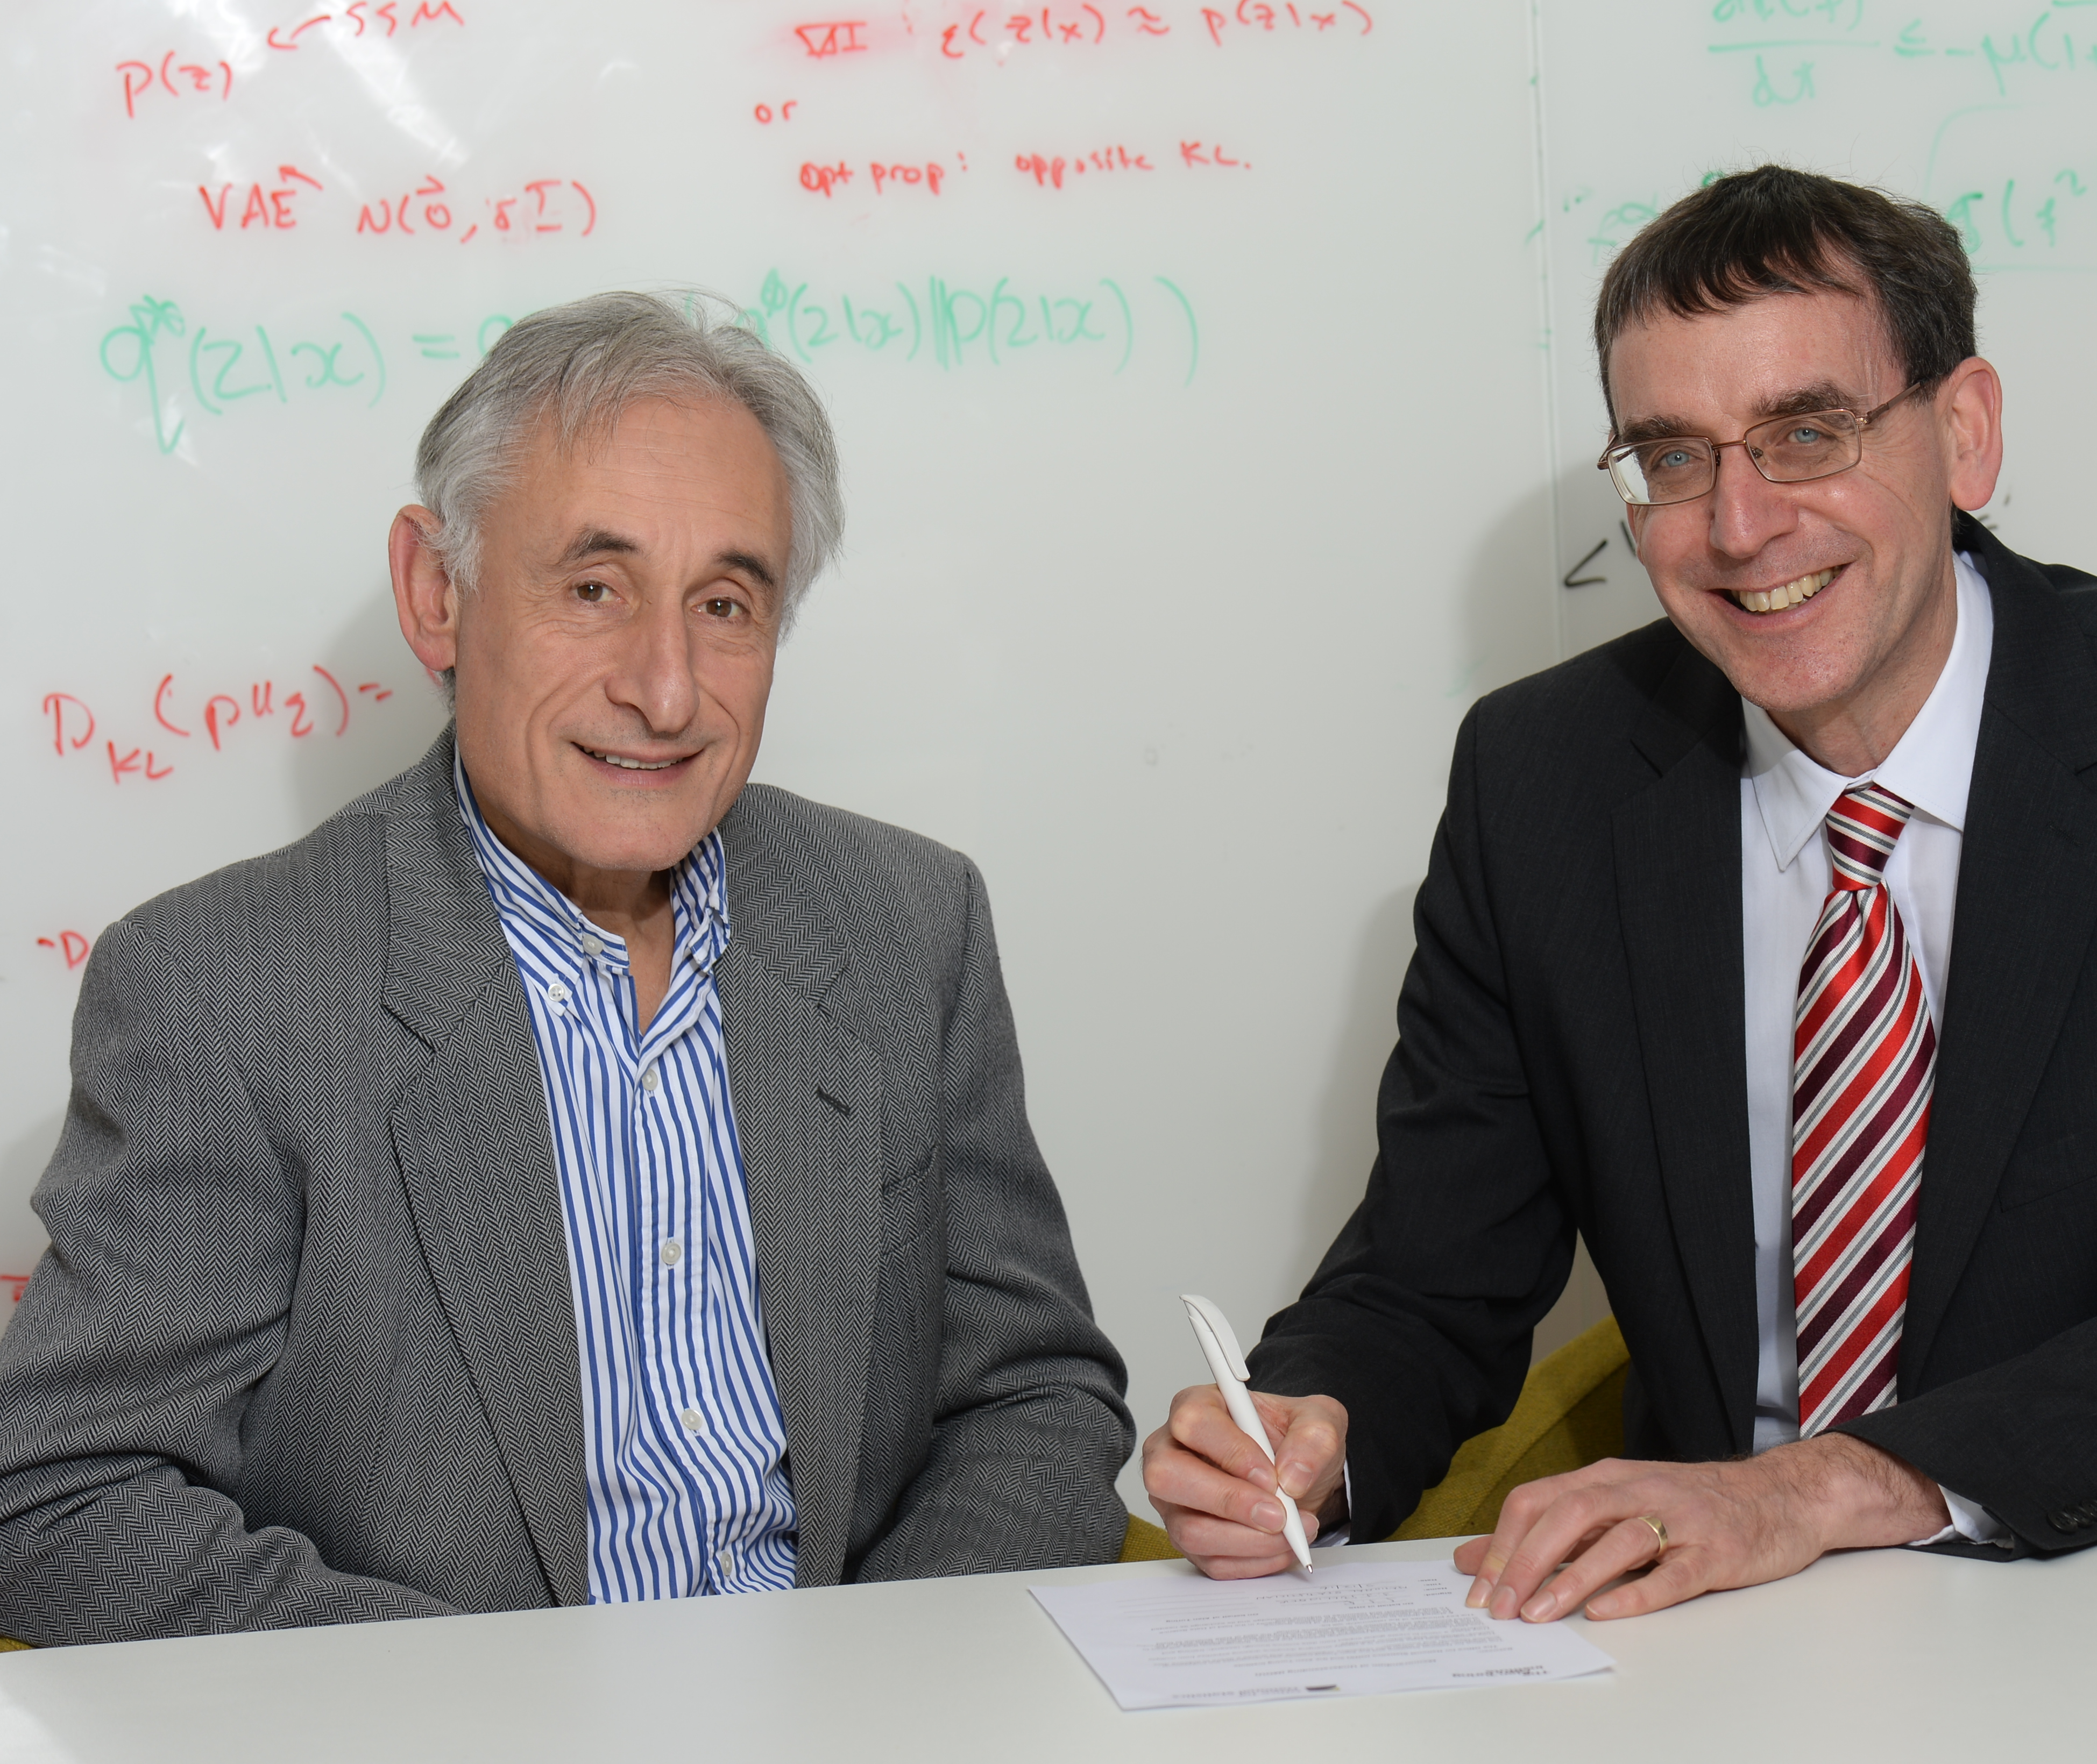
Research Partnerships
MoUs agreed with multiple research partners including universities, research institutes and international stats authorities
Research Funding
Bursaries for 7 MSc candidates in Data Science from October 2016
PhD co-funding with partner universities from April 2017
Public Sector Partnerships
Collaborations with national and devolved government including Cabinet Office, DEFRA, DCMS, DFID and Welsh Government
Alan Turing Institute Director Professor Andrew Blake and National Statistician John Pullinger, December 2016

Slide 8
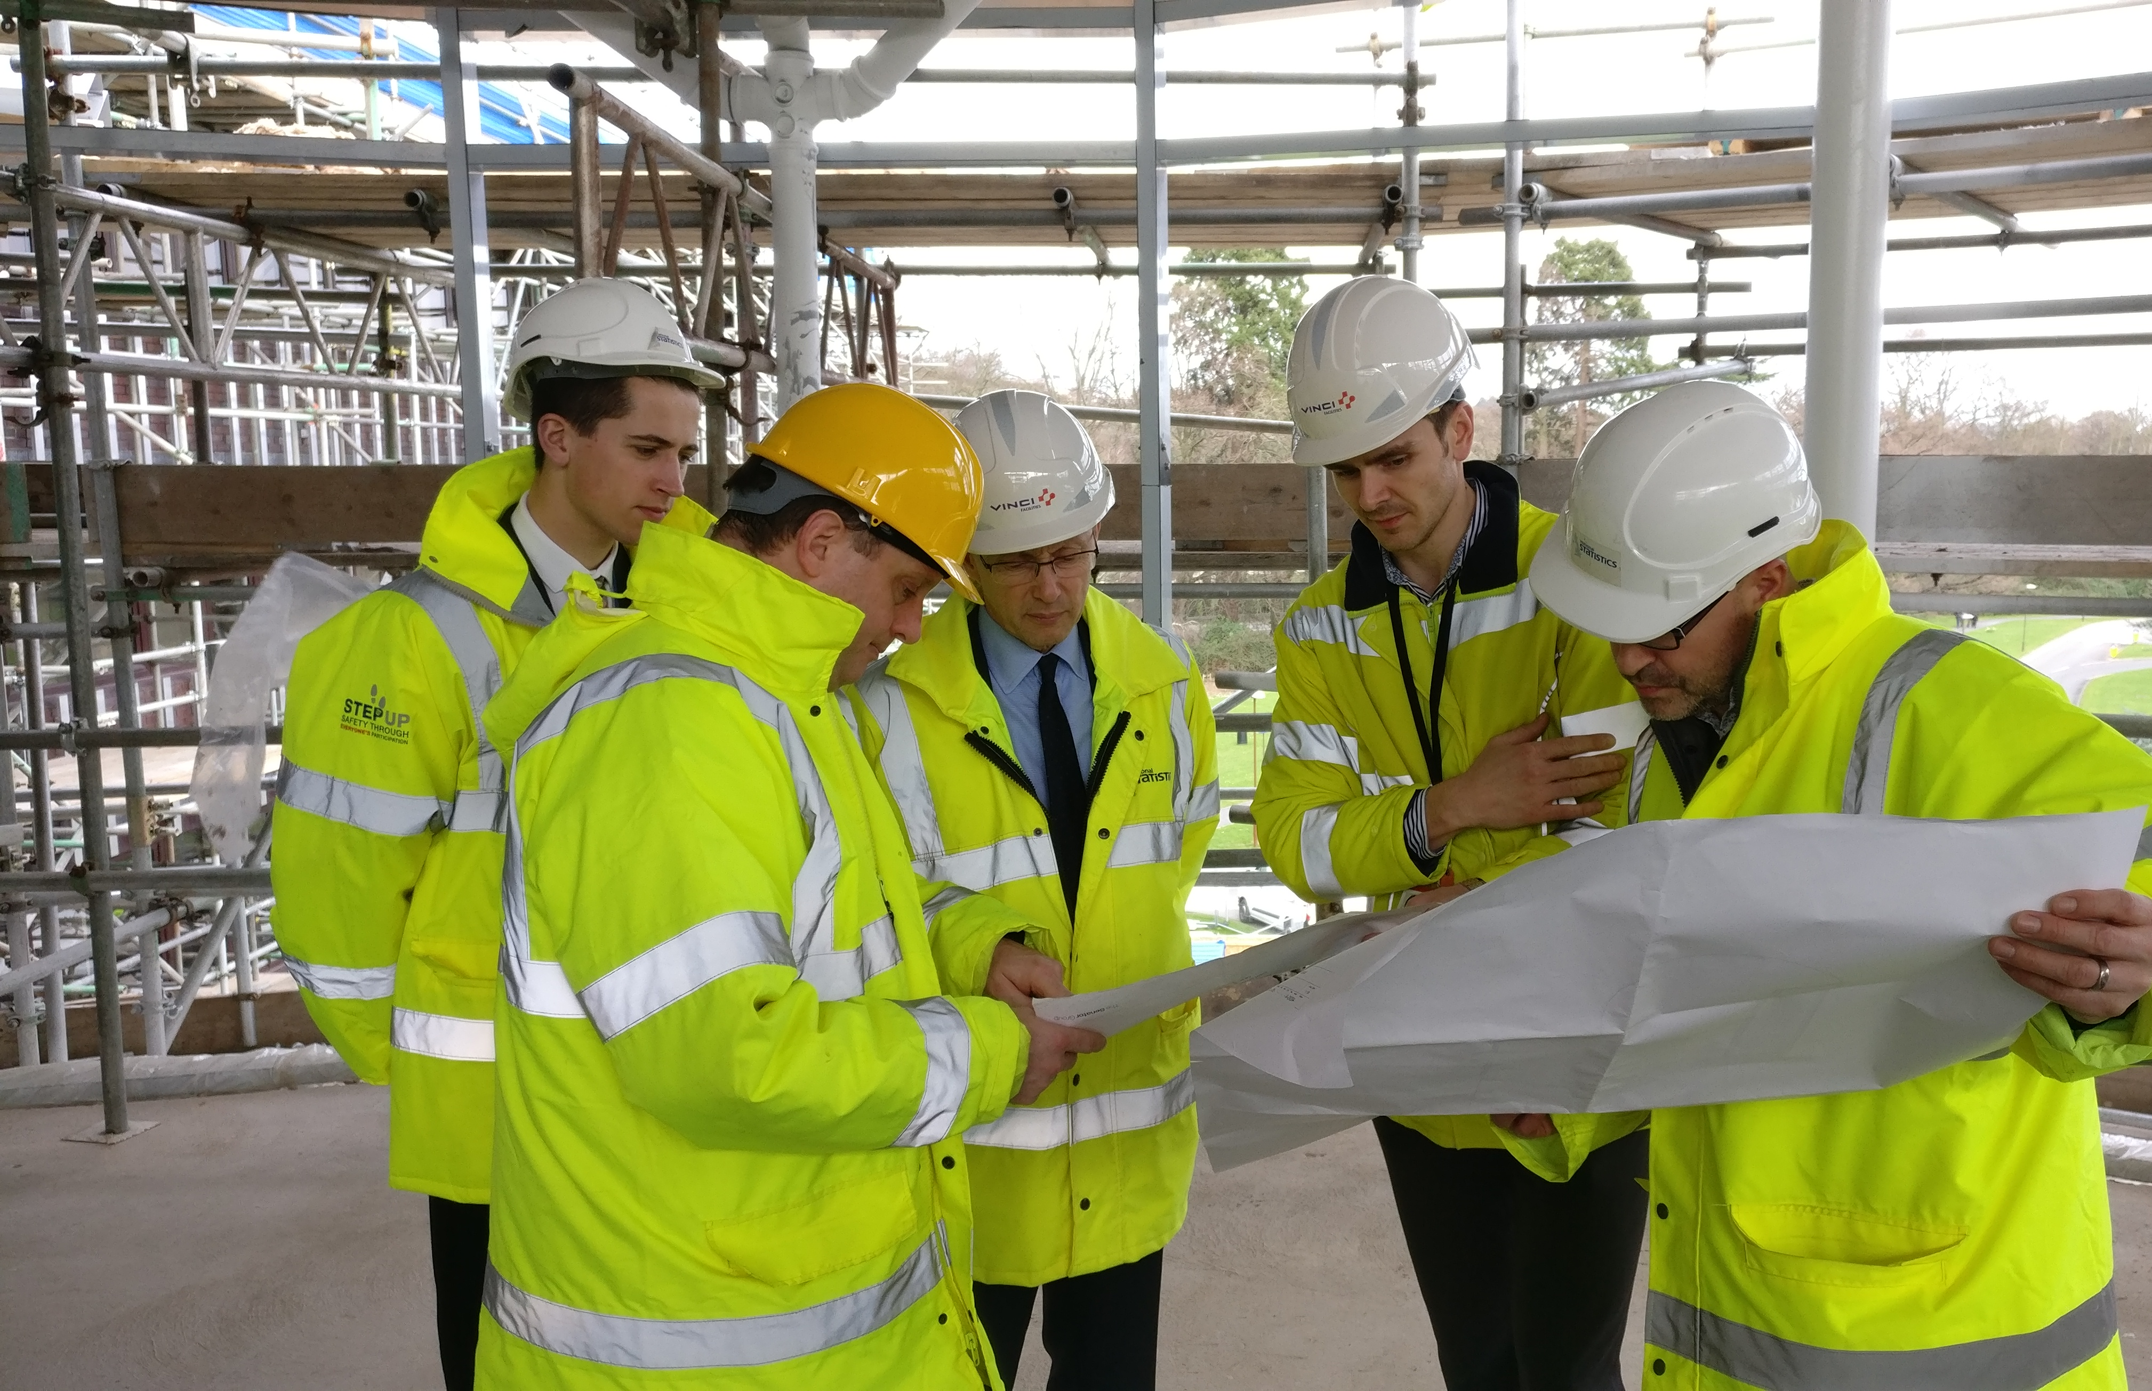
Building the Data Science Campus
Funding approved in Mar 2016
Start-up team in place in Jul 2016
Temporary Campus open Aug 2016
1st Data Scientist in Aug 2016
1st Academic Manager in Sep 2016
Research commenced in Sep 2016
1st Apprentices in Nov 2016
1st research output in Dec 2016
MD joined in Jan 2017
Headcount reached 26 FTE in Feb 2017
Formal launch 27 March 2017
Move to bespoke Campus 31 May 2017
Projected Headcount to reach 50-60 FTE by March 2018
UKSA Chair Sir Andrew Dilnot tours the Campus with
Scott Howell, Jason Ryan and Tom Smith, March 2017

Slide 9
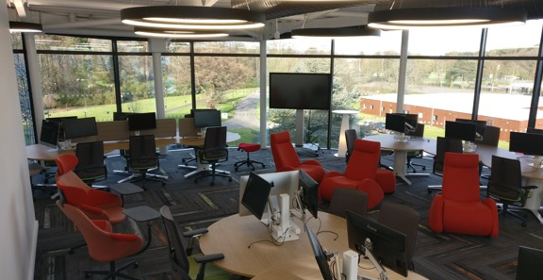
Data Science Campus
ONS Data Science Campus
SYG Campws Gwyddor Data
          email: datasciencecampus@ons.gov.uk
          web: datasciencecampus.ons.gov.uk
twitter: @DataSciCampus
Image credits:
London Transport workers: Gerry Cranham / Fox Photos / Hulton
WiFi pilot 2016: Transport for London: Archive / Getty Images
Data Science Venn Diagram, modified from Drew Conway: http://drewconway.com/zia/2013/3/26/the-data-science-venn-diagram
ONS images: D Johnson and ONS stock
UKSA Chair Sir Andrew Dilnot tours the Campus with
Scott Howell, Jason Ryan and Tom Smith, March 2017

