Slide 1
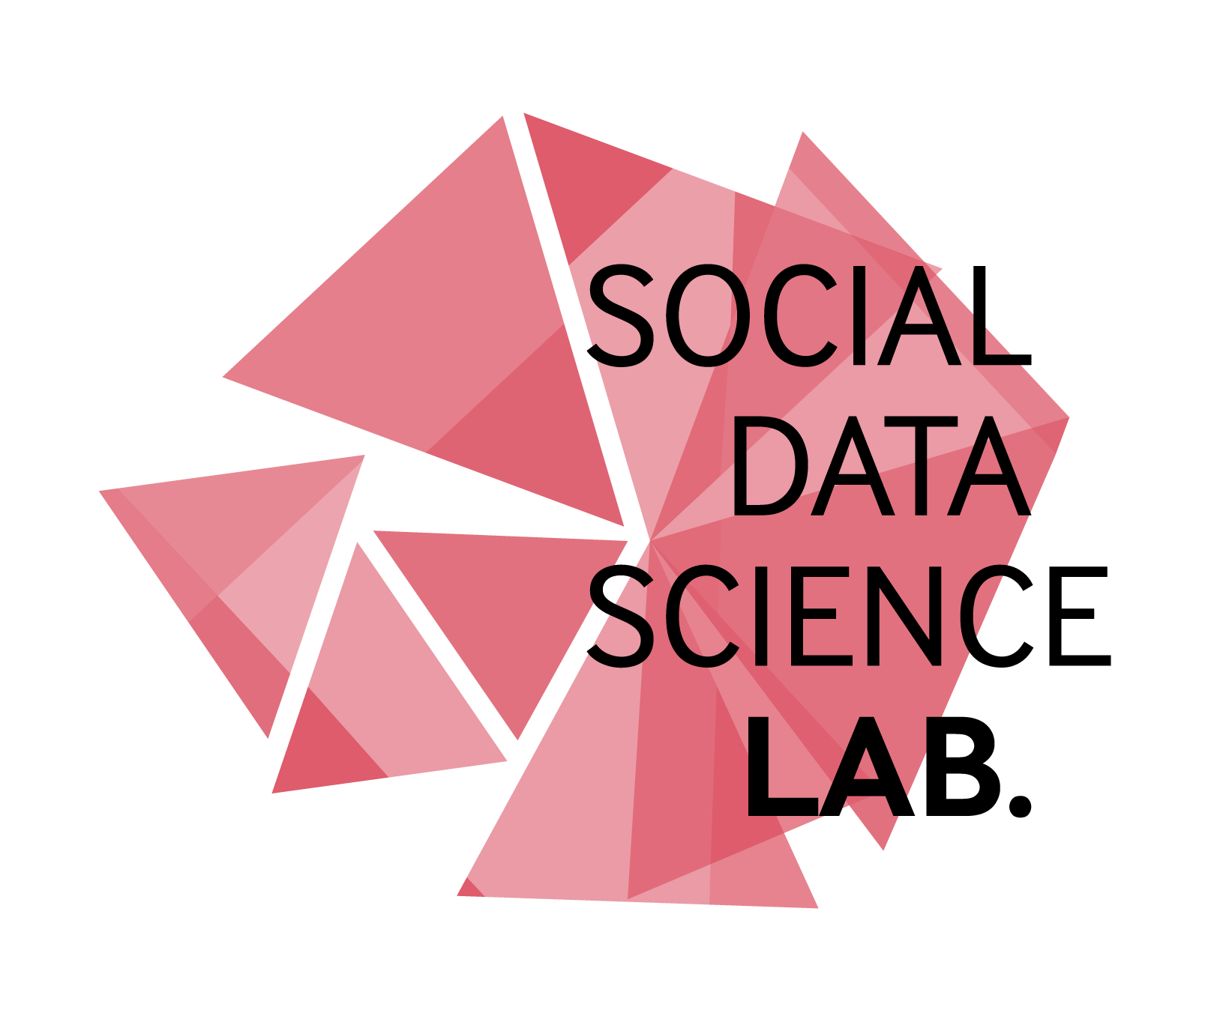
Interdisciplinary collaboration between social and computer science
To date we have been involved in 25 grants amounting to more than £6.75 million, bringing in over £3.25 million directly to the Lab
Address the methodological, theoretical, empirical and technical challenges presented by new and emerging forms of data
Our empirical social data science programme is complemented by a focus on ethics and the development of new methodological tools and technical/data solutions for the UK academic and public sectors
Example projects include:
‘Crime-sensing’ through social media
Predicting the 2015 General Election
Communication strategies for Twitter during food scares
Demographics and representation on Twitter
Detecting hate speech online
Cybersecurity, risk and safety

