Slide 1
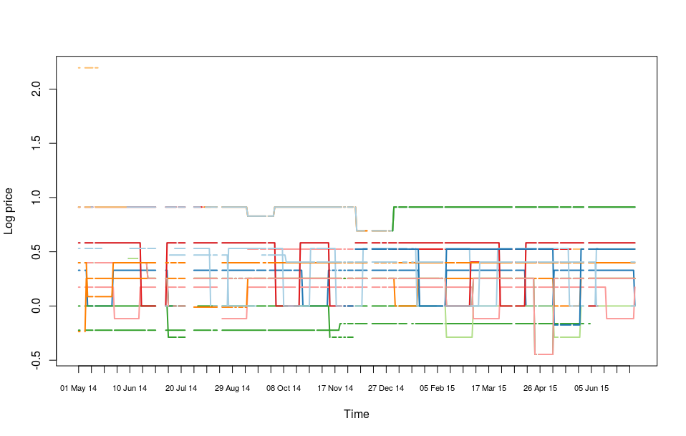
High-frequency inflation estimation using web-scraped data
In collaboration with ONS, Newport
Ben Powell
Institute for Statistical Science
Academic interest:
Computationally demanding,
Novel statistical challenges.
Public interest:
Potential for highly localized inflation figures,
Potential for breakdown or manipulation,
Legal and administrative context is changing rapidly.
1
Notes:
1

