Slide 1
NATO and Contested Sovereignty
Stephen D. Krasner
University of Cardiff
September 2, 2014

Slide 2
Old Challenge for NATO: STATE TO STATE CONFLICT
Deter/defend against the Soviet Union
Create a North Atlantic security community
Make war among NATO members unthinkable

Slide 3
China: A Conventional Challenge

Slide 4
New Challenge for NATO: Contested and Imperfect Sovereignty
Poor Governance: Failed and weakly governed states
Balkans, Afghanistan
Undermining domestic sovereignty:
Russia and its neighbors

Slide 5
Three Meanings of Sovereignty
International legal sovereignty
Basic rule: recognize entities that have territory and juridical independence
Westphalian/Vattelian sovereignty
Basic rule: non-intervention: Each state is entitled to determine its own domestic authority structures.
Domestic sovereignty
Effective governance within a given territory

Slide 6
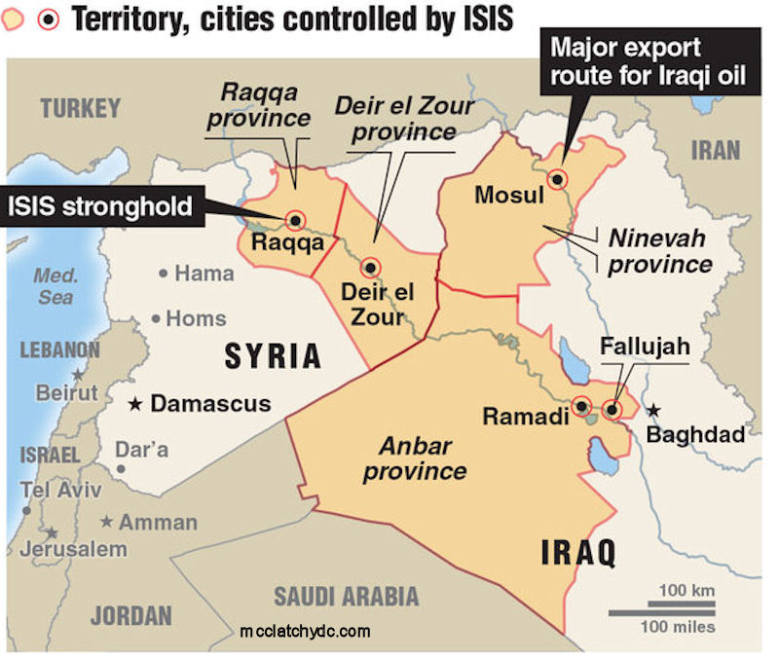
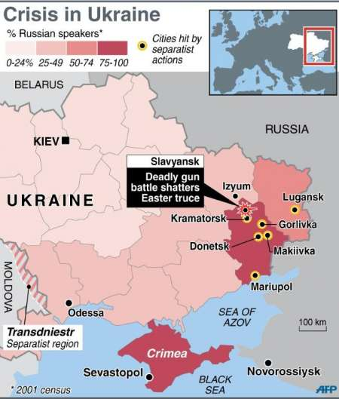
Fundamental Challenge
Failures of domestic sovereignty →
Areas of Limited Statehood

Slide 7
Addressing State Failure
Three Theories of Development
Modernization theory
Economic growth → middle class → better governance and democracy
Institutional Capacity
Greater institutional capacity → security and economic growth
Elite Bargains/Rational Choice institutionalism
Greater openness (democracy and economic growth) only when elites abandon rent seeking

Slide 8
Goals
Modernization Theory
Put countries on the path to Denmark
Institutional capacity
Provide security and better governance
Elite Bargains/Rational Choice Institutionalism
Good Enough Governance
Some security
External balancer
Internal balance of power among competing elites
Some economic growth
Some protection of physical integrity human rights

Slide 9
Policy Prescriptions
Modernization Theory
Give money and maybe technical assistance
E.g Foreign Assistance = 0.7 percent of GDP
Institutional capacity
Provide technical assistance and resources
E.g. train and equip Iraqi army

Slide 10
Elite bargains/rational choice Good Enough Governance: Not Somalia; Not Denmark
Provide security assistance to specific groups
Make it worthwhile for the ANA to fight for us not them
Maintain enough forces to act as a credible balancer
Conclude Bilateral Security Agreement and SOFA with Afghanistan
Change economic incentives for elites
open global trading opportunities
Accept patronage and associated corruption
Combat personal corruption
Condition aid/support on protecting core human rights

Slide 11
Russia
Putin’s Goals
Stay in power
Deter domestic opposition
Discourage defection in the FSU

Slide 12
Putin’s Tactics
Conventional international politics
Annexation of Crimean
New international politics:
Create areas of limited statehood
Ukraine, Moldova, Georgia
Classic Russian imperial politics
Defend Slavic/Russian minorities
Czarist Russia in the Balkans before WWI
Putin’s Russia in the FSU

Slide 13
Sources of Russian Leverage in FSU
Poor Governance
All FSU except the Baltics
Significant Russian minority
Latvia, Estonia, Kazakhstan, Ukraine
Control of energy (exports or supply)
All countries except Azerbaijan
Security balance
All countries

Slide 15
No options for NATO/West
All of the Stans and Belarus
Poor governance
Energy dependence (X or M) on Russia
Limited military power
High NATO engagement could undermine NATO credibility
PFP has costs

Slide 16
Limited Options: Ukraine
Russia has violated Budapest Memorandums
NATO/West/EU could provide:
Economic incentives from the EU
Security assistance
However, Russia
will siphon away aid by raising energy prices
may not accept outright defeat of Russian separatists

Slide 17
Ukraine: Possible Outcomes
I. Unified Ukraine moving closer to the West
II. Finlandization
III. Ukraine within Russia’s sphere of influence
Confederal or federal state
Extensive minority protections for Russian
Some economic growth
Some improvement in governance over time
The most likely outcome

Slide 18
Azerbaijan and Georgia: Best Outcome would be the status-quo
Basic goal: good enough governance
Azerbaijan
Autocratic regime and poor governance but
Alternative energy outlets
Aided NATO in Afghanistan
Aliyev wants to balance against Russia and Iran
Georgia
Has instituted democratic reforms; better governance
Has lost territory
Cannot respond to Russian military pressure
Abkhazia and South Ossetia will be frozen forever

Slide 19
Baltics
Putin’s play: weaken domestic sovereignty
Appeal to Russian minorities in Estonia and Latvia
Subversion
Stay below any Art. 5 threshold

Slide 20
NATO’S RESPONSE
NATO can make credible commitments to the Baltic states
NATO should:
Station more troops on a rotating basis
Place NATO forces on the Latvia Estonia Russian border
Continue intelligence cooperation
Strengthen Latvian security forces: police, special forces
NATO cannot make credible commitments to any other FSU country

Slide 21
Holbrooke Model for Non-NATO Members
Non-Angelic
Trade peace for justice
Heavily discount the future
Incorporate as many players as possible
Include enough spoilers so that other spoilers can be marginalized
Confederal/consociational states with high regional autonomy
Third Parties can provide
Resources
Monitoring
Authoritative decision making
High representative in B-H
Incentives for reform
Trade agreements
EU membership or association for relevant states

Slide 22
NATO: AMBITION VS CREDIBILITY
Credibility
Defend Baltics
Accept confederated Ukraine
Identify best local ally that can
Maintain stability
Not attack us
If no local ally rely on short term kinetic interventions
Incredibility
Claim to defend Ukraine when it cannot be defended
Claim to promote democracy where it cannot be promoted
Claim to defend western human rights where they cannot be defended

