Slide 1
Data Science in Official Statistics: The Big Data Team
Owen Abbott
Office for National Statistics

Slide 2
ONS Big Data team
Launched in January 2014
The Big Data team:
focus on high priority ONS challenges that may be solved through new forms of data or the application of data science techniques to help deliver better statistics
undertake research (including data access, technological, methodological, ethical)
support ONS business areas in implementation
Approach has involved a combination of collaborative working/partnerships and practical projects

Slide 3
Who we work with
Commercial Sector
International
Privacy Groups
Government
Academia
Notes:
Over the two and a half years, we have worked with a number of organisations and partners
Working on cross-european projects with other national statistical institutes
Working with commercial sector on exploring sources of data
Working with academia on data science research projects
Working with privacy groups to explore perceptions and acceptability of work in this area
Working across government to share research and best practice

Slide 4
Projects
Job vacancy statistics
Demographics,
migration
smart meters
SIC: Web scraping
enterprise websites
Inflation: Web scraping
Online retail prices
Food diary coding
Property: Zoopla Data

Slide 5
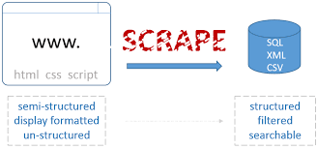
Cross cutting research
Privacy and ethical issues
Investigating new big data tools and technologies – transforming ONS data infrastructure
Web-scraping
Adjusting for bias in big data sources
Notes:
Need to pay attention to ethical and privacy issues on an ongoing basis
Work to support the transformation of ONS’ data infrastructure – investigation of big data technologies – Spark for fast processing, Graph databases for data linkage

Slide 6
Some specific projects

Slide 7
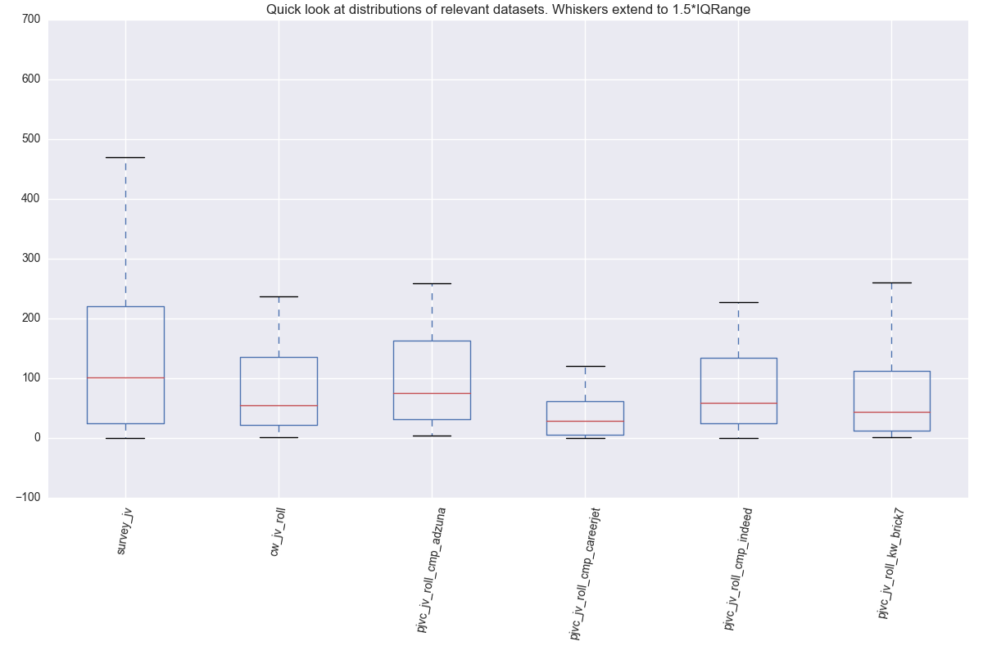
Job Vacancy Statistics
Notes:
useful findings here:
The box and whisker plot shows how the different sources compare. Basically, all the on-line sources are underestimating the survey counts. This may be due to a number of factors - jobs not being advertised on-line, jobs being advertised via agencies, mismatch between advertising employers and survey reporting units
Once you remove outliers (i.e. very large diffferences between counts) the counts from enterprise websites are closer to the survey than any of the job portals.
Indeed is then closest to enterprise website counts followed by Careerjet.

Slide 8
Census Address register
2011 Census spent £6 million enumerating vacant properties
Notes:
Using big data sources to provide intelligence on addresses
e.g. caravans
vacant properties – to improve address register and hence field operations
Gated Communities
Private rented properties

Slide 9
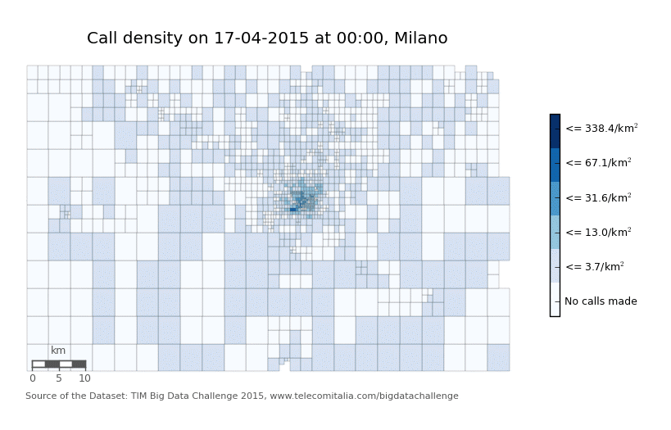
Population mobility and migration
Notes:
Population estimates and travel to work statistics using mobile phone data
Milan – visualisation using open data
Working on samples of mobile data for travel to work flows

Slide 10
Challenges
Obtaining data
Understanding data quality
Assessing (and correcting for) bias
Sampling issues
Large datatsets
Training datasets for ML
Integrating sources
Linkage
Estimation
Tools and Environments
Ethics

Slide 11
Further Information
Big Data Team
www.ons.gov.uk/aboutus/whatwedo/programmesandprojects/theonsbigdataproject
Email: ons.big.data.project@ons.gov.uk

Slide 12
Projects I
Housing Data
Living Costs and Food Survey coding
British Crime Survey coding
Household type from Smart Meter data
Identifying caravan parks from Aerial Imagery
Using graph databases in record linkage
Commuting patterns from Mobile phone data

Slide 13
Projects II
Web scraping
Job Vacancy statistics
Enterprise statistics
Price indices
SDGs (corporate sustainability reporting)
Ethics/policy/service
Using Twitter to examine internal migration
Address and Business Index – both matching services
Methodology - Adjusting for biases in Big Data
Methodology – Using Big Data in Small Area Estimation

Slide 14
Projects III
Exploring data sources
Opencell ID
Oyster Card
Facebook
Twitter
Linkedin
Land Registry Price Paid
TED (EU procurement)
Zoopla
Moneysupermarket
Google Trends
Satellite Imagery
Probably some more….

