Slide 1









Alcohol Brief Interventions
(2 hour Training Course)

Slide 2

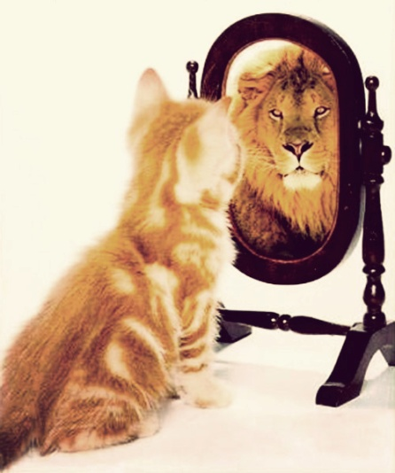
To Increase .....
Understanding... the scope of alcohol harm and how brief interventions work
Knowledge... of alcohol definitions and the tools & techniques of brief interventions
Skill... To deliver and succeed
and importantly to increase
Confidence

Slide 3
What we hope to cover
Why Alcohol? What are the issues?
What can you do about it?
How do you do it?
What are the barriers?
Discussion

Slide 4
What we hope to cover
Why Alcohol? What are the issues?
What can you do about it?
How do you do it?
What are the barriers?
Discussion

Slide 5
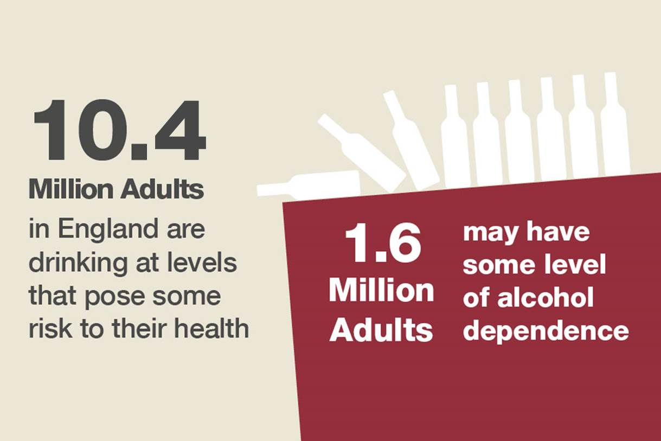

Slide 6
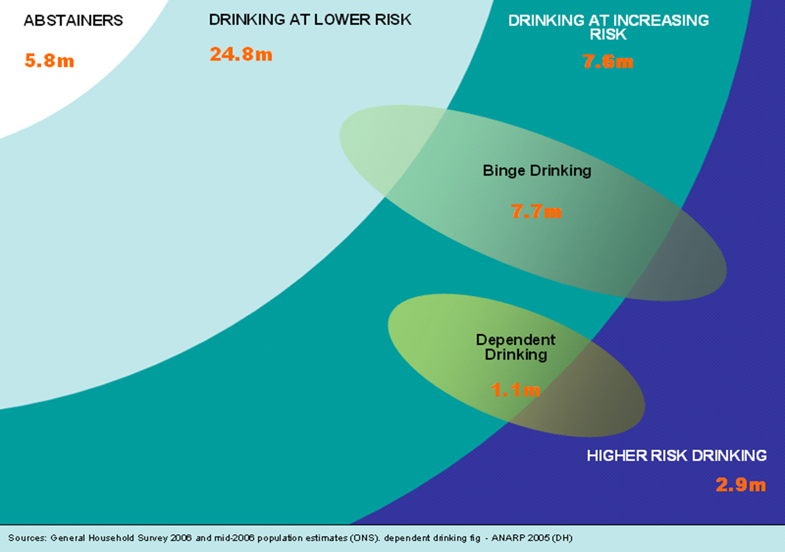
Drinking “At Risk” groups
7.1m
17%
25.2m
59%
8.5m
20%
7.3m
17%
1.6m
4%
1.9m
4%
Source: Health Survey for England 2013 (ONS) & Adult Psychiatric Morbidity Survey 2007
Notes:
Who is doing the drinking?
15% of the population don’t drink (abstainers)
Luckily, over 60% of the population drink within the lower-risk guidelines
But that leaves 20-25% of the population who are drinking “at risk”
And 5% of the population drink at higher-risk

Slide 7
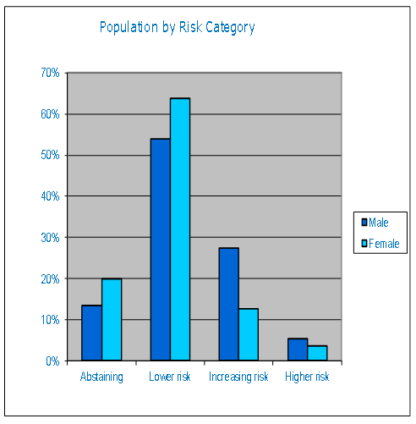
Where do you sit?

Slide 8
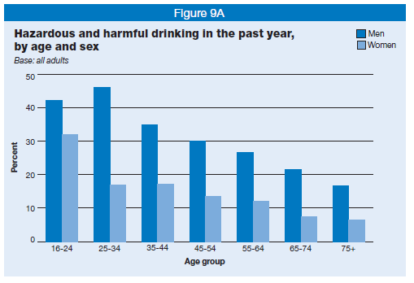
Hazardous and harmful drinking
(APMS)

Slide 9
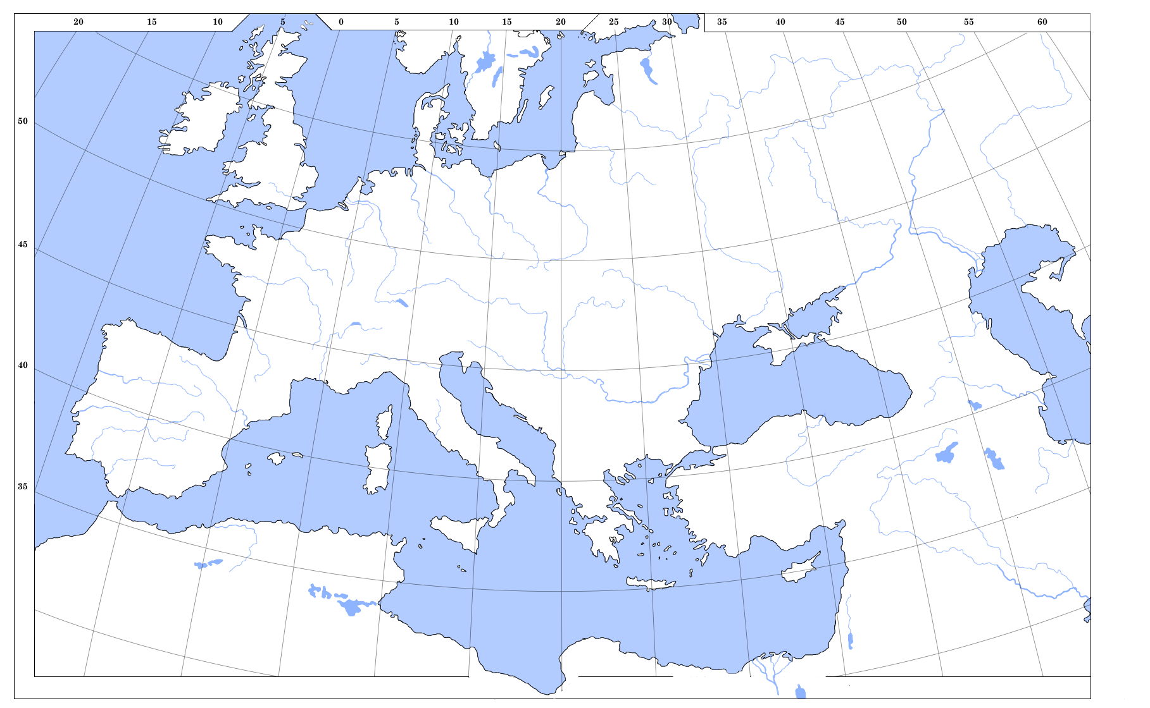

Our Future Drinkers
% 13-year –olds who have been drunk at least twice
HBSC 2009/10 Health Behaviour in School-aged Children- top 15
Health Behaviour in School-aged Children 2009/10

Slide 10
40% of alcohol drunk by 10%

Slide 11
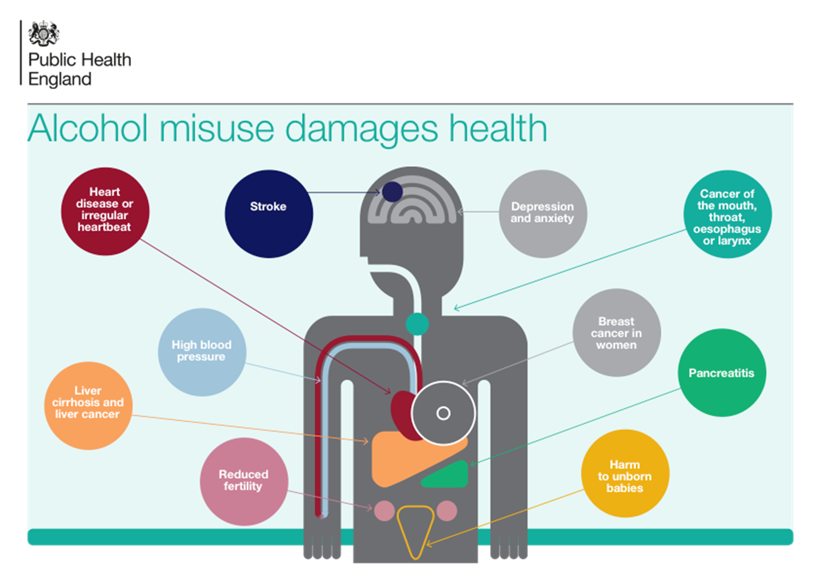
Health Harms

Slide 12
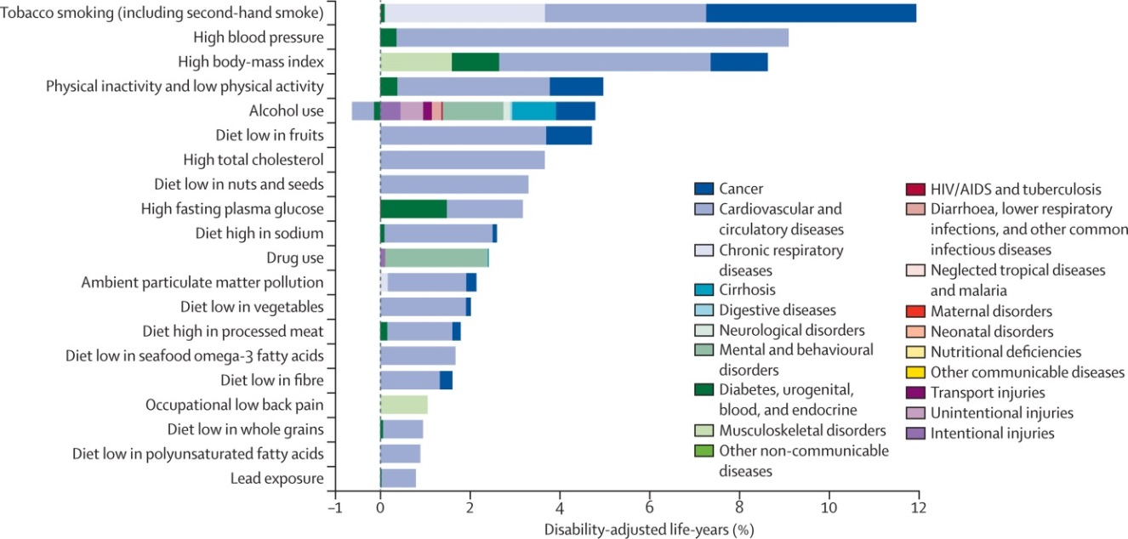
Burden of disease attributable to 20 leading risk factors for both sexes in 2010, expressed as a percentage of UK disability-adjusted life-years

Slide 13
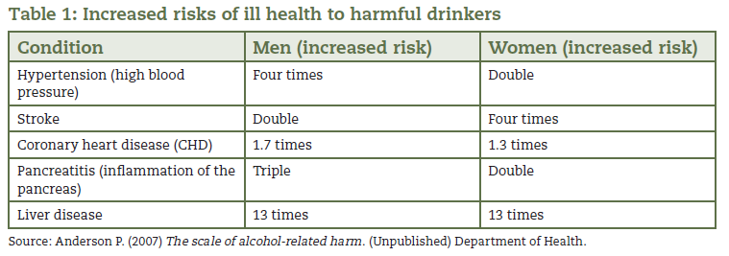
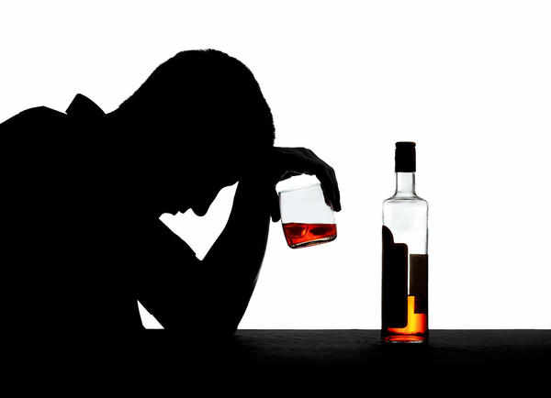
Increased risks of ill health to harmful drinkers

Slide 14
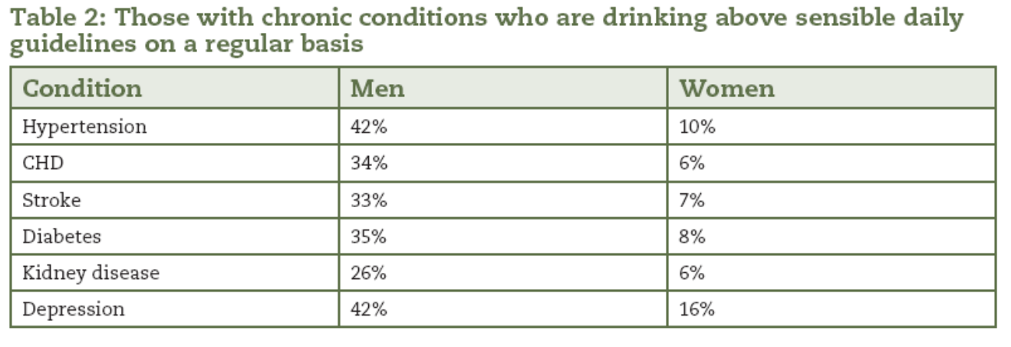
QOF registers and risky drinking

Slide 15
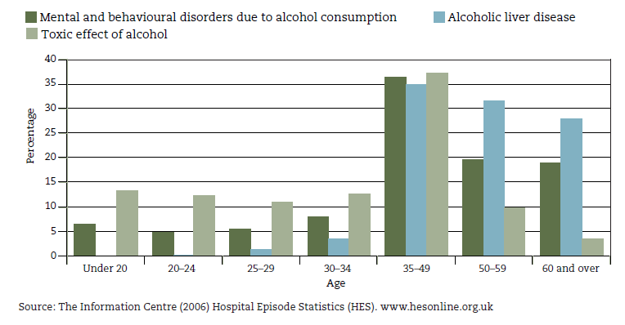
Tip of the Iceberg.......
Percentage of NHS admissions where there was a primary or secondary diagnosis of selected alcohol-related conditions by age

Slide 16
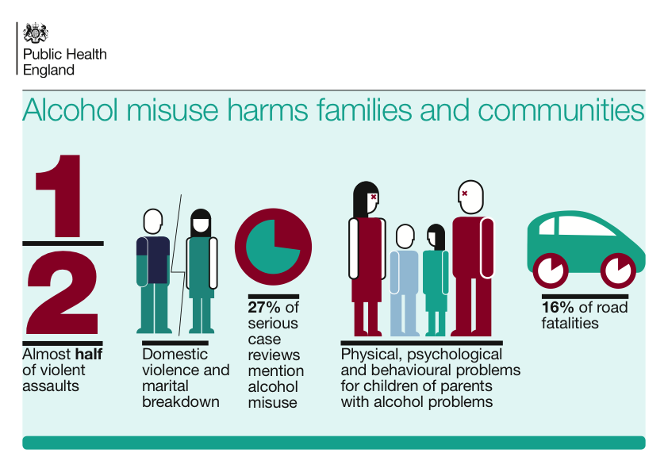
Social Harms from Alcohol

Slide 17
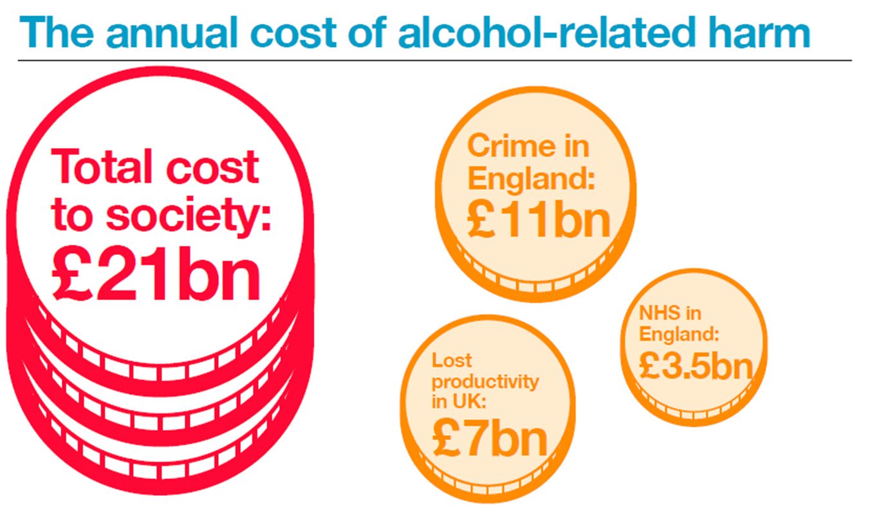

Slide 18
So who is at risk of alcohol related harm?
Potentially 10 million people in England
It’s not just the hard core cases
It doesn’t take much to be at risk
It’s about minimising the risk where possible

Slide 19
Do we have a problem with Alcohol?
What’s the answer?

Slide 20
What we hope to cover
Why Alcohol? What are the issues?
What can you do about it?
How do you do it?
What are the barriers?
Discussion

Slide 21
Public perception of alcohol risk
Most people are unaware that they are drinking above the lower-risk guidelines
Many do not see drinking above the lower-risk guidelines as a problem
Many aware that alcohol caused liver problems, but few aware of its contribution to cancers

Slide 22

What is an Alcohol Identification & Brief Advice (IBA)?
“A short, evidence-based, structured conversation about alcohol consumption with a client to motivate and support the individual to think about and/or plan a change in their drinking behaviour in order to reduce their consumption”
NHS Scotland (2009)
ABI = Alcohol Brief Intervention
ABI
IBA
IBA=Identification and Brief Advice

Slide 23
‘Have A Word’ builds on
Making Every Contact Count (MECC)
Refines MECC further into
Making Every RELEVANT Contact Count

Slide 24

The ‘Good to Go’ Boxes
The “right person” to intervene :
In regular contact with people; and
see the relevance of discussing alcohol
Present at the teachable moment when people may be ready and able to engage with IBA
Practical opportunity to deliver IBA – have the time, have a quiet & confidential space for discussion

Slide 25

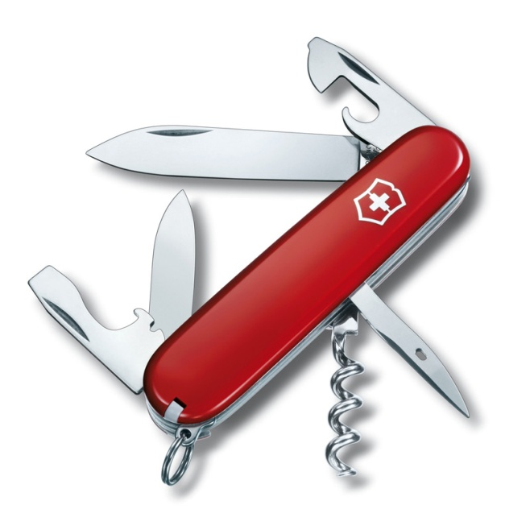
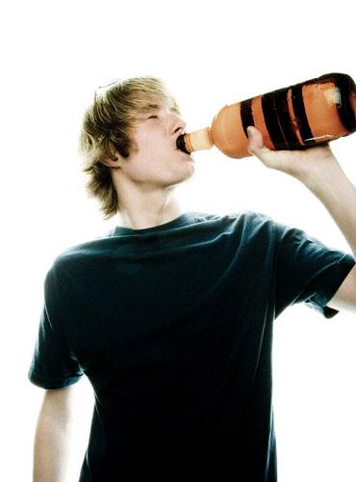
IBA
IBA is an efficient, attentive and evidence based intervention that can:
Provide a valuable opportunity to facilitate referral of cases of alcohol dependence to specialist services
Significantly reduce the alcohol drinking levels of people who have been identified as drinking above lower-risk guideline

Slide 26

What’s the point of IBA?
The primary goal of an alcohol brief intervention (IBA) is to reduce harmful drinking through showing the client...
What the consequences of their drinking are likely to be
What the client can do about it
What help and support can be accessed

Slide 27
What we hope to cover
Why Alcohol? What are the issues?
What can you do about it?
How do you do it?
What are the barriers?
Discussion

Slide 28
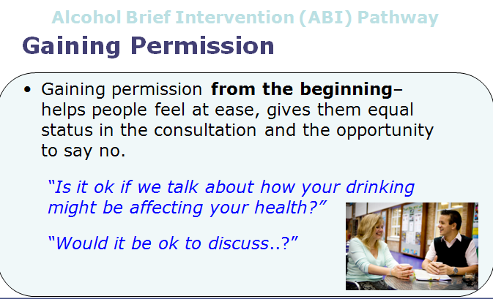
Alcohol Brief Intervention (ABI) Pathway
Notes:
You may already be doing this – there is a ‘subtle difference’ between asking whether someone smokes or drinks is not asking permission to raise the issue
This simple thing sets the collaborative tone for the next couple of minutes right at the start of this brief conversation
This helps the clients engage,
engenders their ownership of the issue and
reduces resistance
MI Principles - Always gain permission before giving advice
Communicate risk sensitively - Smoking, Alcohol, Obesity

Slide 29
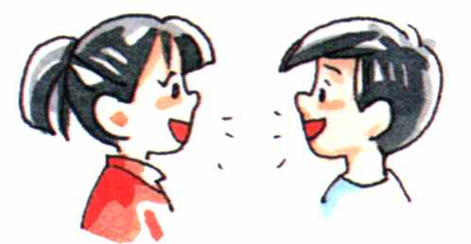
Ways to start a healthy chat
Alcohol Brief Intervention (ABI) Pathway
“What has made you want to... Cut down?”
“It sounds like... you might be interested in changing...”
“You mentioned that…. You are drinking every night”
Or more direct
“Do you drink often?”
  “What do you like about…”
  “What do you dislike…”
“So how much do you spend on alcohol?”
Notes:
Presenter’s notes (25 minutes for slides 15-30):
Starting a conversation about healthy lifestyles can be daunting for some.
The main part is to listen to what the other person is saying and wait for them to raise the issue. That way they are showing they might be interested in talking about it.
For example they may say that they have decided that for a new year’s resolution they will eat more healthy.
At this point you could respond by saying “What has made you want to eat healthily?”.
You could say “I recently did this course and they said there’s lots of information on eating healthily on the Change4Life website and the Cardiff Healthy Cities website”.
Other examples from Smoking Brief Intervention
What is it you like about your smoking?
Do you always plan on being a smoker?
What would need to happen for you to stop smoking?
What would it take for you to quit smoking?
Who else have you spoken to about your smoking?
So how much are you spending on cigarettes these days?
indirect questions to start with.
E.g. Do you have any concerns about……
Have you thought about…..
How do you feel…..
What do you think…..
Are you aware of risks….
• Or more directly
Do you know……..
Tell me about……..

Slide 30
Providing Advice
Alcohol Brief Intervention (ABI) Pathway
Advice giving from professionals is important but how it is “given” is even more crucial
Ask
  What do you think about how your drinking is affecting your health?
  What do you already know about drinking and health?
  Would you like more information about....?

Slide 31

Open Questions
Alcohol Brief Intervention (ABI) Pathway
Closed questions lead to a yes-no response . Open questions will give you more information.
  How do you feel about your drinking?
  What could you change to make your drinking?
  What are the things you like and don’t like about...........?

Slide 32

Expressing Empathy
Alcohol Brief Intervention (ABI) Pathway
Empathy is not sympathy, pity, warmth, acceptance or identification.
Empathy is showing an active interest in and effort to see the world through their eyes
  Explore opinions and ideas about the behaviour
  Accurate reflection
Notes:
Notes for reference
Empathy is not sympathy, a feeling of pity or camaraderie with the person. Neither is it identification: “I've been there and I know what you’re experiencing. Let me tell you my story”. Empathy is not warmth, acceptance, genuineness or client advocacy.
Empathy is an active interest in and effort to understand the other’s internal perspective, to see the world through their eyes. “put self in clients shoes”
Clinicians high in empathy are curious, approach the session as an opportunity to learn about the client. Explore the clients opinions and ideas about the behaviour.
The clinician makes active effort to understand the client point of view, shows interest, offers accurate reflections of what the client has said

Slide 33

Reflective Listening
Alcohol Brief Intervention (ABI) Pathway
Listening well and reflecting back what you’ve heard helps to clarify information and leads to greater exploration.
  “So what you’re saying is...”
  “Can I just check...”
Summarising
Choosing what you reflect back can make a difference:
  Affirm and emphasise previous successes and change talk
Notes:
Notes for reference
Reflective listening is a skill that can be used throughout the conversation and involves reflecting back to the patient what you’ve heard, helping to clarify and gain more information.
Summarising can help guide the conversation by first reflecting back the patient/clients arguments against change but by ending with the clients/patients arguments for change.
E.g. “so you enjoy smoking and its hard for you to quit because you have a lot of stress at the moment... But at the same time I can tell you really want to give up too because you’re worried about the effect it may have on your health... It seems like it really is important for you to try to quit”
Standard phrase:
“So you feel.....”
“It sounds like you.....”
“You’re wondering if.....”
Affirming and emphasise previous success by reflecting them back to the client helps to build self-efficacy (confidence).
Reflecting listening can help increase decisional balance towards positive change
The more this skill is practiced the more accurate reflections become. Giving accurate and complex reflection shows empathy.

Slide 34

Alcohol Brief Intervention (ABI) Pathway
Shaping and Agreeing Goals
Capitalise and build on the persons suggestions for change
Agree what they will do
Include referral to services
Follow up; telling them you are interested in finding out how they got on will support their behaviour change

Slide 35

Alcohol Brief Intervention (ABI) Pathway
Raise the issue or look/ listen for ‘Triggers’
Exit strategy – remember that you or the client can stop the conversation at any time
Close the conversation but keep an ‘open door’ and sign post or refer onto further support
Screen and give feedback
Listen for readiness to change
Use a suitable approach
Build Confidence
Coping Strategies
Info and advice
Menu of Options
Motivate

Slide 36
Opportunities for change
Social issues
Relationship problems and domestic violence.
Criminal behaviour (e.g. driving offences, breach of the peace, shoplifting).
Unsafe sex/sexual risk taking.
Personal risk taking.
Financial problems.
Bereavement (which can lead to use of alcohol as a coping strategy).
Effects on physical health
Accidents/injuries.
Gastrointestinal system, including dyspepsia (indigestion), gastritis and pancreatitis.
Various liver abnormalities.
Cardiovascular system, including cardiac arrhythmias, hypertension and stroke.
Reproductive system problems and unexplained infertility.
Cancers of the mouth, pharynx, larynx, oesophagus, breast and colon.
Other effects, including seizures, gout and eczema.
Effects on mental health
Anxiety and panic disorders.
Depressive illness.
Amnesia, memory disorders and dementia.
Treatment resistance in other psychiatric illnesses and as a factor in relapse.
Self-harm.
Occupational effects
Repeated absenteeism, especially around weekends.
Impaired work performance and accidents.
Employment difficulties.

Slide 37

Alcohol Screening
What is it?
…it is a method of identifying alcohol consumption at a level sufficiently high enough to cause concern.

Slide 38

Requirements of a Screening Tool
Ease of Use
Easy to interpret
Brevity
Effective at case finding
Non threatening / judgemental to the patient
Accuracy for the user

Slide 39
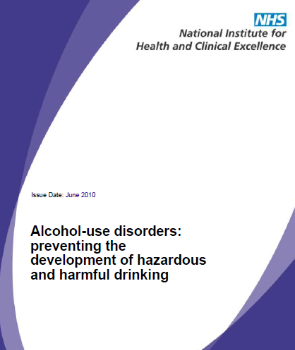


NICE Guidelines
Complete a validated screening
questionnaire, e.g. AUDIT (Alcohol
Use Disorders Identification Test), or
AUDIT-C, or FAST
16 ,17 years
Adult
Not to be used for 10-15 years

Slide 40
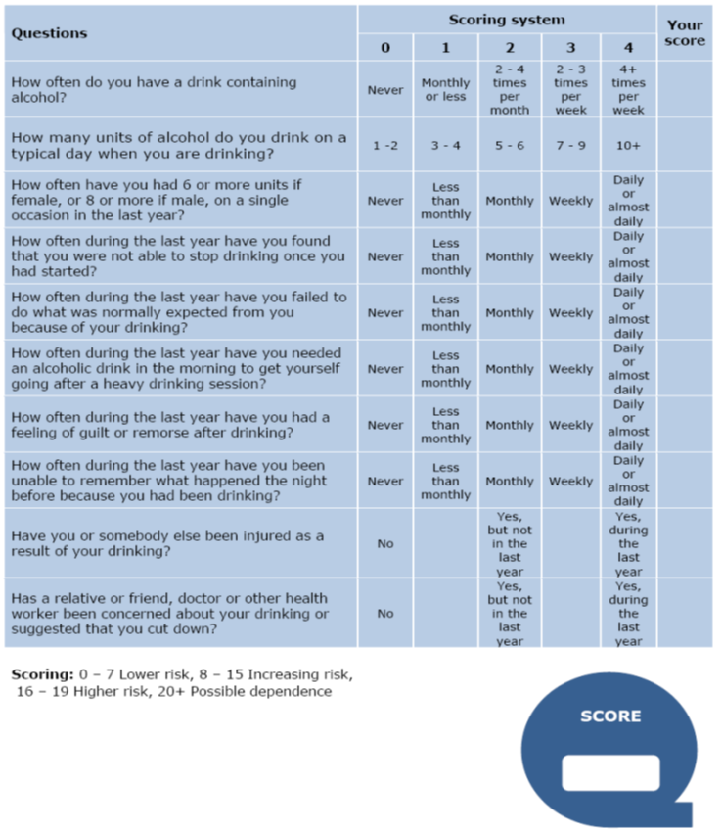
GOLD STANDARD
AUDIT
(Alcohol
Use Disorders Identification Test) but 10 questions version too long for many settings

Slide 41


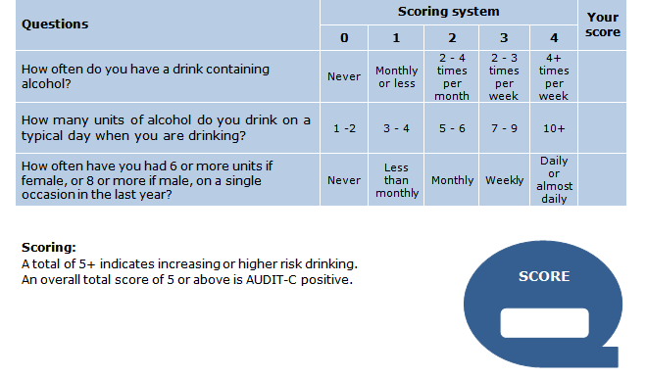
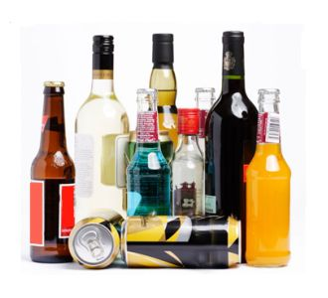

Slide 42
Adults 18 +
Alcohol Care Pathway
Teachable Moment
Initial Screening Tools
FAST
AUDIT - C
Positive
Result
Negative
Result
Full Screen
AUDIT
No action
AUDIT Score
20+
Possible Dependence
AUDIT Score
16-19
Higher-risk
AUDIT Score
8-15
Increasing-risk
AUDIT Score
0-7
Lower-risk
Consider Referral to
Specialist Services
Brief Advice

Slide 43
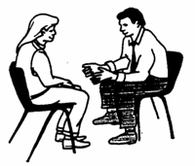
The AUDIT-C Score (0-12)
If time, carry out full AUDIT
0
1
2
3
4
5
6
7
8
9
10
11
12
Non Drinker
Sensible Drinking
Lower Risk
Hazardous Drinking
Increasing Risk
Harmful Drinking
Higher Risk
Potentially
Addicted / Dependant
Public Health Wales Alcohol Brief Interventions Train the Trainer Course

Slide 44
FAST
(Fast Alcohol Screening Test)
FAST | Scoring system |  |  |  |  | Your score
 | 0 | 1 | 2 | 3 | 4
How often have you had 6 or more units if female, or 8 or more if male, on a single occasion in the last year? | Never | Less than monthly | Monthly | Weekly | Daily or almost daily
Only answer the following questions if the answer above is Never (0), Less than monthly (1) or Monthly (2). Stop here if the answer is Weekly (3) or Daily (4).
How often during the last year have you failed to do what was normally expected from you because of your drinking? | Never | Less than monthly | Monthly | Weekly | Daily or almost daily
How often during the last year have you been unable to remember what happened the night before because you had been drinking? | Never | Less than monthly | Monthly | Weekly | Daily or almost daily
Has a relative or friend, doctor or other health worker been concerned about your drinking or suggested that you cut down? | No |  | Yes, but not in the last year |  | Yes, during the last year

Slide 45
Adults 18+
Alcohol Care Pathway
Teachable Moment
Screening Tools
FAST
AUDIT - C
AUDIT – C 9+
FAST 6+
Possible Dependence
AUDIT – C 7-8
FAST 4-5
Higher-risk
AUDIT – C 4-6
FAST 3
Increasing-risk
AUDIT – C 0-3
FAST 0-2
Lower-risk
Positive
Result
Negative
Result
Consider Referral to
Specialist Services
Brief Advice
No action

Slide 46
Alcohol Units
Drink | Volume (ml) | Volume (cl) | % Alcohol | Alcohol (ml) | Alcohol (cl) | UNITS
SAMPLE | 100 | 10 | 10% | 10 | 1 | 1
Pint Beer | 568 | 56.8 | 4% | 22.7 | 2.3 | 2.3
Pint Beer | 568 | 56.8 | 5.2% | 29.5 | 3.0 | 3.0
Wine | 175 | 17.5 | 13% | 22.8 | 2.3 | 2.3
Wine | 250 | 25 | 14% | 35 | 3.5 | 3.5
Spirit | 25 | 2.5 | 40% | 10 | 1 | 1

Slide 47

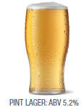
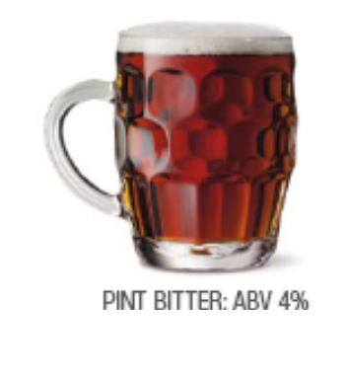

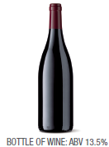

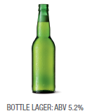
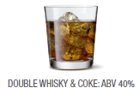
3 UNITS
2.3 UNITS
2.3 UNITS
1 UNIT
1.7 UNITS
10 UNITS
2 UNITS

Slide 48
Typical night in
8.4
UNITS
Half

Slide 49
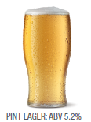
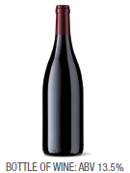
Typical night out
14
UNITS
Half
Half

Slide 50


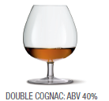
Special night out
Half
10 UNITS

Slide 51
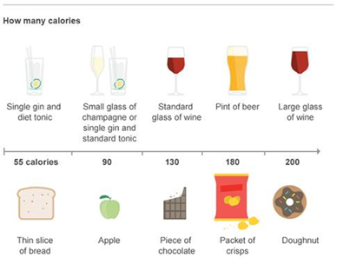
Alcohol and Calories

Slide 52

UK Lower-risk Guideline GuidelineEngland
Risk | Men | Women
Lower risk | Both men and women should not regularly drink more than 14 units per week, spread over three or more days
Increasing risk | Regularly drinking 15-50 units per week | Regularly drinking 15-35 units per week
Higher risk | More than 8 units per day on a regular basis or more than 50 units per week | More than 6 units per day on a regular basis or more than 35 units per week

Slide 53
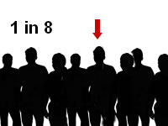

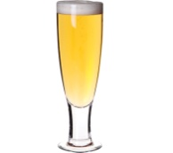



How much impact can YOU really have?
The Numbers Needed to Treat (NNT) for Alcohol Brief Interventions = 8
The average reduction in alcohol consumption (per week) is 38 grams, which equates to 4-5 units.
or
or
Kaner et al (2009) Effectiveness of brief alcohol interventions in primary care populations (Review)
Raistrick et al (2006) Review of the effectiveness of treatment for alcohol problems

Slide 54


When to Refer on?
Clients should be referred to their GP or other
specialist services when...
They express the desire to talk in-depth with someone about alcohol
They display alcohol dependence
Have a high level of alcohol harm, physically and mentally
When brief intervention does not seem appropriate

Slide 55


Referral Agency
Drinkline
0300 1231110
Mon - Fri 9am – 8pm
Weekends 11am – 4pm

Slide 56

Always be on the look out for
A naturally occurring life transition or health event that motivate or activate individuals to spontaneously adopt risk-reducing health behaviours.
Timing formal interventions to take advantage of these naturally occurring events increase the effectiveness of that behaviour change.

Slide 57



Motivational Interviewing...
Patient Centred
Collaborative Conversation
Dancing Not Fighting

Slide 58


Frames- the Structure of ABI
Feedback-
Tell the person what they scored. Link their drinking to the situation. Be realistic!
Responsibility-
It’s the individuals’ own responsibility to change.
Advice-
Set a daily (& weekly) limit
Have alcohol free days
Menu-
Give them a range of options
Empathy-
Empathic, Non Judgmental
Self Efficacy-
Positive message. Boost their self confidence -“ You can do it!”

Slide 59
Giving Brief Advice
What you need to cover...
  An understanding of units
  An understanding of risk levels
  Knowing where they sit on the risk scale
  Benefits of cutting down
  Tips for cutting down

Slide 60

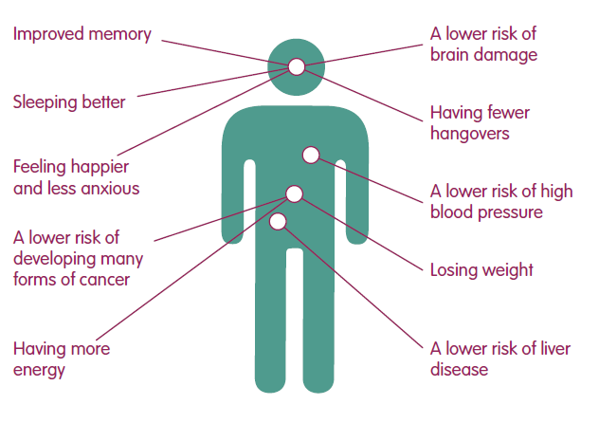
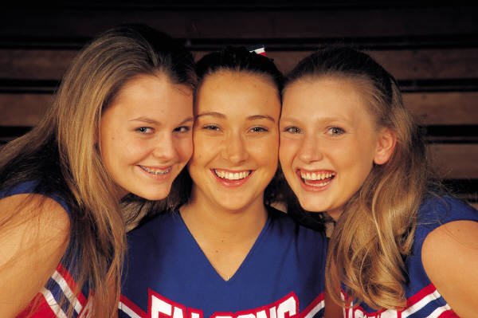
Advice
Health Advice
Feel better in the mornings
More energy!
Improved skin
Fitter, faster
Weight control

Slide 61

Benefits
Psychological, Social and Financial Benefits
Lower risk of accident or injury
Less chance of getting into fights
Developing better relationships
Improved Self esteem
More time
More money
Seen in a different light at work

Slide 62


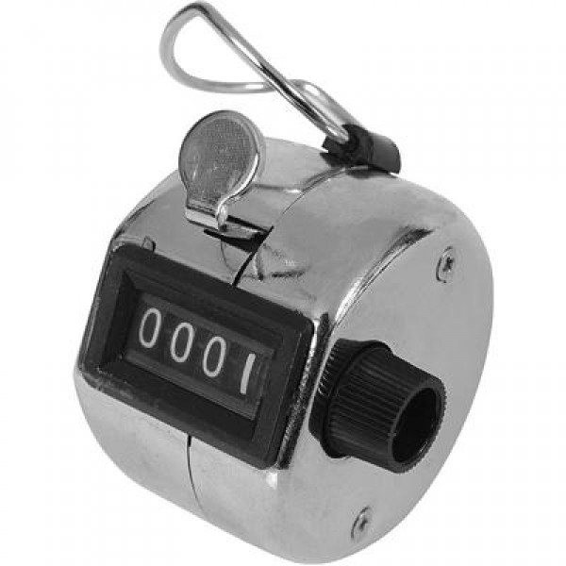
Menu of Options
Simple and Straight Away
“Have drink free days
every week”
“Keep track of how much
you drink”

Slide 63


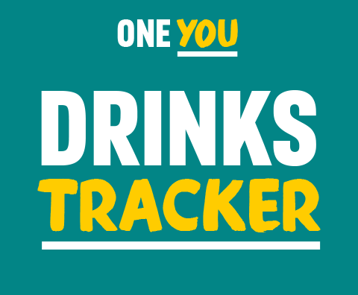
It may seem like you don't drink much, but a drink or two most evenings can do harm to your body. From making you gain weight to increasing your risk of cancer, alcohol can have serious effects on your body.
The more you drink, and the more often, the greater the risk to your health.

Slide 64
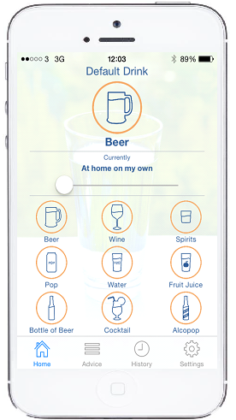
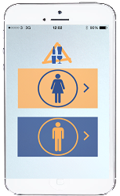
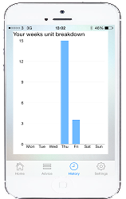
One Drink, One Click App
Launched February 2015
Available Free for an iOS i-Phone
Available from Apple- ‘One Drink- One Click’

Slide 65
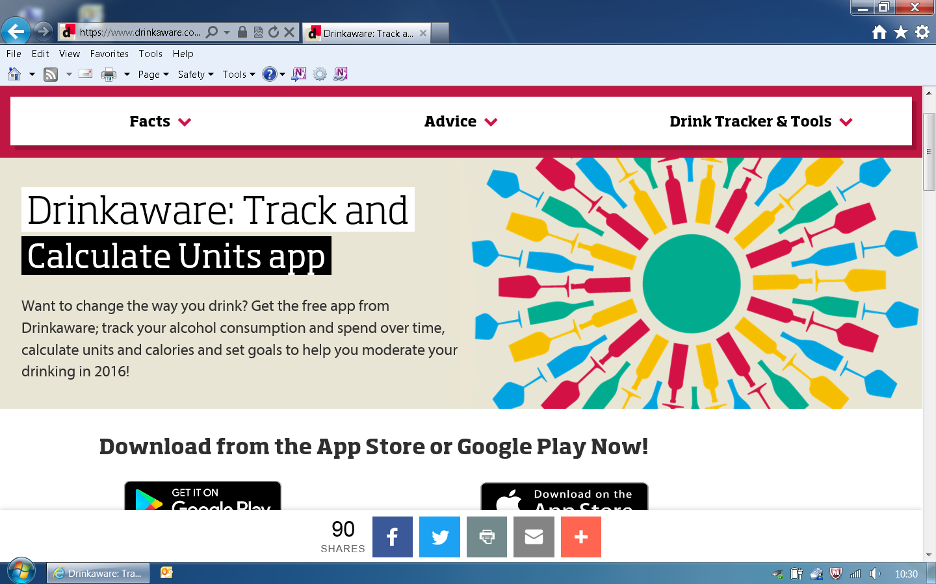
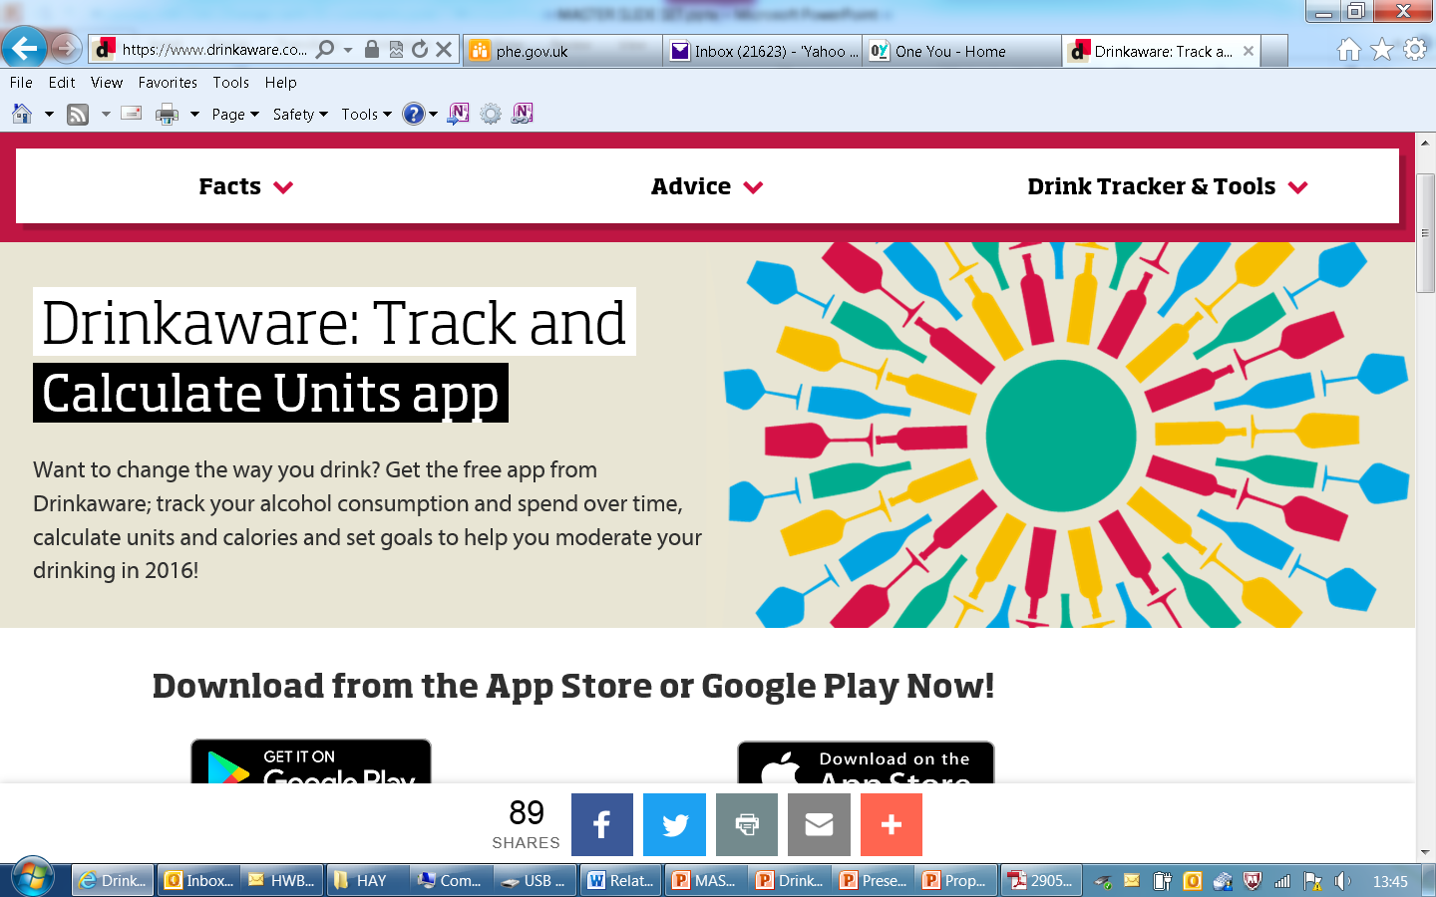
Drinkaware

Slide 66

Menu of Options
“Swap your usual for...
A smaller drink
A lower strength drink
A soft drink
A later drink
A meal time only drink”
“Drink to relax? Try...
Exercise
Pamper time
Music, movies, books
Use the money saved to do something new”

Slide 67

Menu of Options
Tips for a Night Out
Make a plan – set yourself pre-night out limits
Set a budget – only take a set amount of cash out with you
Start later – but don’t start at home
Take your time – don’t get in rounds
Sit one out – have a soft drink when its your round
Stay hydrated – have a few glasses of water through the night

Slide 68
What we hope to cover
Why Alcohol? What are the issues?
What can you do about it?
How do you do it?
What are the barriers?
Discussion

Slide 69
What barriers exist to delivery?
And what facilitators exist?

Slide 70
Challenges – grouped into
Systems issues
      GP record systems
      Insufficient time
      Payments
      Creating demand for services at capacity
Training
      Using the screening tools
      Delivering the brief advice
Comfort / confidence
      Asking the screening questions
      Dealing with a irate or reluctant client

Slide 71
Assessment tools recording on clinical systems
GP system templates on Alcohol Learning Resources
http://www.alcohollearningcentre.org.uk/Topics/Browse/PrimaryCare/GPTemplates/
      EMIS LV
      EMIS PCS
      TPP SystmOne
      iSOFT Synergy
      InPS Vision
      Microtest

Slide 72
Insufficient time to deliver brief advice
Screening and feedback on the patient’s AUDIT score and what it means about their level of risk may be the most important part of Identification and Brief Advice
Brief advice does not have to be extensive. A simple discussion about:
      Benefits of cutting down
      Tips for cutting down
This should take 2-3 minutes
Give the patient written information to take home to reflect on later

Slide 73
IBA will increase demand for alcohol services already at capacity
Studies have shown that less than 2% of those screened need to be referred to specialist alcohol treatment services
To date, IBA programmes have not created a demand on treatment services that has not been met
Only those screening 20+ on full AUDIT should be considered for referral
Many patients will be unwilling or unready to be referred for further assessment
If a patient is alcohol dependent, they are entitled to have their condition assessed and be offered appropriate treatment

Slide 74
Not be trained to deliver the alcohol brief intervention
Research has shown that effective brief advice can be as simple as:
      Feedback about the patient’s AUDIT score and what that score means about their level of risk
      Providing further information in the form of a leaflet that the patient can take home
The brief advice needs to be delivered there and then following screening. Research has shown that referring the patient to someone else for the brief advice will result in fewer than 50% getting that advice. Patients will not go - You will have missed the opportunity

Slide 75
Tension: AUDIT-C vs FAST vs
Full AUDIT
No screening tool is perfect
Full AUDIT (10 questions) is the best tool we have available for identifying the level of alcohol risk
The initial screening tools (AUDIT-C and FAST) are used to RULE OUT patients from further investigation
AUDIT-C and FAST are both 80% as accurate as Full AUDIT
If the patient is NEGATIVE on AUDIT-C or FAST – stop there
Full AUDIT score helps you decide what to do next

Slide 76
Not confident asking AUDIT questions
No screening tool is perfect
AUDIT is the best we have
      AUDIT was developed by the World Health Organisation
      AUDIT is used all over the world
      Alternatives (CAGE , MAST) are ONLY about dependence
10 questions of AUDIT
      1-3 all about CONSUMPTION (this is AUDIT-C)
      4-6 all about DEPENDENCE
      7-10 various CONSEQUENCES of drinking
Give feedback about TOTAL score

Slide 77
Dealing with irate client “Why are you talking to me about alcohol?” (1)
We talk to everyone about lifestyle factors including:
      Smoking
      Weight management
      Diet
      Exercise; and
      Alcohol
Alcohol is the 3rd biggest risk factor for ill health and premature death (behind smoking and high blood pressure)

Slide 78
Dealing with irate client “Why are you talking to me about alcohol?” (2)
To measure your level of risk, we use an objective screening questionnaire - AUDIT - that is used all over the world
My job is to:
      Give you feedback about your score on this questionnaire
      Explain what that score means as far as your level of risk; and
      Provide you with information about how to reduce that risk
It is up to you what you do with this information
Offer written information for taking home and reflection later

Slide 79
Patient reluctant to take up a referral
That is OK
You may have “planted a seed” that will germinate later
Your role is to:
      Assesses the level of risk
      Give the individual the feedback about that level of risk
      Provide information about how to reduce that level of risk
It is up to the patient what they do with that information
The most important thing is to raise the issue and have a brief conversation about alcohol

Slide 80

Points to Remember
Use a non-confrontational manner
Do not use if the client is intoxicated
Tell the client what you are doing and why
Discuss confidentiality
Acknowledge a low score (positive reinforcement)

Slide 81
Which Menu of Options
Over to you:
Name: Fictional Person or Character
Age:
Occupation:
Likes:
Teachable Moment:
What Advice would you give:?
?

Slide 82

So why do people change?
Formal interventions facilitate natural change
But the following need to be present before people change their behaviours:
  Readiness to change
  Willingness to change
  Ability to change
  Tipping point

Slide 83
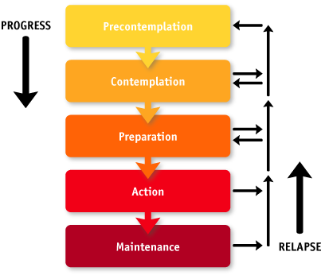
Stages of Change?
ABI

Slide 84


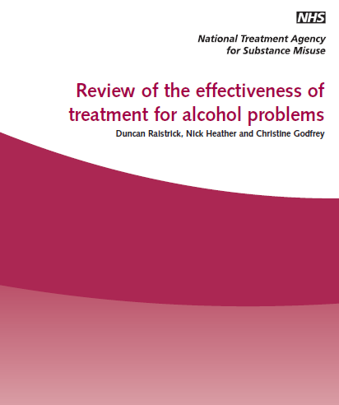
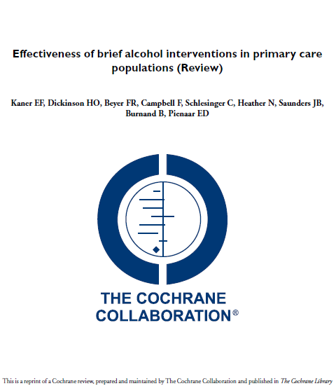
?
All very nice, but does ABI actually work?
56 controlled trials indicate that for every eight people who receive simple alcohol advice, one will reduce their drinking to within lower risk levels
Brief interventions are effective and cost-effective!

Slide 85




Any Questions? Drop us an email
Craig Jones
Senior Health Promotion Practitioner
craig.jones@wales.nhs.uk
Carol Foster
Public Health Practitioner
carol.foster@wales.nhs.uk
Follow us on
Twitter @haveawordUK
www.facebook.com/haveawordcampaign
Website www.haveaword.org
Rhiannon Hobbs
Senior Public Health Practitioner
rhiannon.hobbs@wales.nhs.uk

