Slide 1
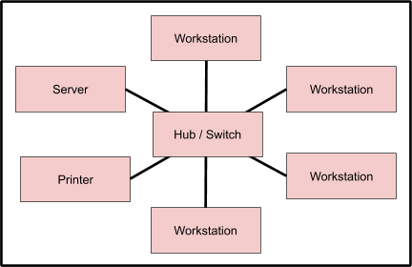
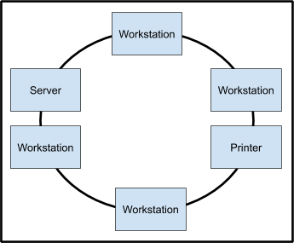
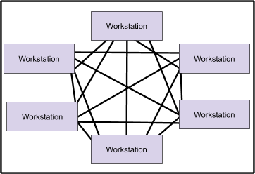
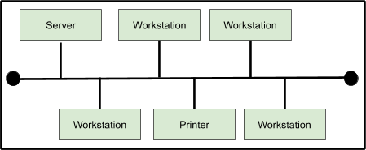
Network Fundamentals | Revision Mat
5. Application Layer
4. Transport Layer
3. Network Layer
2. Data Link Layer
1. Physical Layer
DoS Attack
- This is a technique where malicious users can inject SQL commands into existing SQL statements.
- Injected SQL commands can alter SQL statements and compromise the security of information held in database systems.
A computer network is a group of computer systems and other computing hardware devices that are linked together. Through the use of communication channels, networks enable communication and resource-sharing to take place among users. In simple terms a computer network can be defined as two or more computers which are connected together.
SQL Injection
- This is a technique where malicious users can inject SQL commands into existing SQL statements.
- Injected SQL commands can alter SQL statements and compromise the security of information held in database systems.
Forms of Cyberattack
In Mathematics 4 x 2 is the.
Methods of Identifying Vulnerabilities in Computer Systems
Password-based
- The following types of password attacks can be carried out by an individual / computer program:
- Dictionary Attack
- Brute Force Attack
- Guess
Shoulder Surfing
- This type of attack uses direct observation to get information from a user.
- It is relatively simple to perform as it can involve standing next to someone and watching them as they fill out a form, or enter a PIN number.
IP Address Spoofing
- IP address spoofing involves an attacker changing the IP address of a website so that a visitor who types in the URL of a website is taken to a fraudulent website.
- The attacker can then use this website to steal sensitive data.
Social Engineering
- Social engineering involves tricking a user into giving out sensitive information such as a password by posing as a system administrator.
- This type of attack is normally carried out through phishing emails.
Types of Malware
Virus
Worm
Trojan
Keylogger
Adware
Spyware
Typical Contents of TCP/IP Packet
Typical Protocol Rules
- The source address
- The destination address
- Information which enables the data to be reassembled into its original form
- Other tracking information
- The data itself
- A checksum that checks that the data has not been corrupted
The process of how the two devices will establish their readiness to communicate with one another
How the sending device will determine that it has finished sending a message.
The data compression method to be used
How the receiving device will indicate that a message has been received

Slide 2
Network Fundamentals | Glossary
Network
Network Interface Card
A NIC (Network Interface Card) enables desktop and laptop computers to connect to a network.
LAN
A network can be set up as a local area network which means it operates over a relatively small area e.g. a single building.
WAN
A wide area network is created when multiple LANs are connected together.
Switch
A switch is used to network multiple computers together.
Hub
A network hub is a device that allows multiple computers to communicate with each other over a network.
Router
A router is a hardware device that routes data from a LAN to another network connection.
Gateway
A gateway is a hardware device that acts as a “gate” between two computer networks.
Bridge
A bridge connects two or more local area networks (LANs) together.
Access Point
An access point is a device, such as a wireless router, that allows wireless devices to connect to a network.
PAN
A personal area network refers to the interconnection of devices within the environment of an individual user.
MAN
A metropolitan area network is similar to a local area network, however unlike a LAN it can span an entire city or campus.
VPN
A virtual private network is an encrypted connection from a device to a network which takes place over the Internet.
Ring
A ring topology is where each workstation, server, printer etc. is connected together in a ring so each one is connected to two other devices.
Bus
A bus topology is where each workstation is connected to a single cable known as a backbone which links all of them together.
Star
A star topology is where each workstation has its own cable that connects to a switch or a hub.
Mesh
In this type of network topology each workstation is interconnected with each other..
Packet
A packet is a small amount of computer data sent over a network.
Circuit Switching
Circuit switching provides a dedicated temporary link between two nodes which allows data to be transmitted.
Packet Switching
The process of sending and receiving packets is known as “packet-switching”. Packet switching works by delivering packets of data from one node to another using a designated device such as a switch or router.
Protocol
A protocol is an agreed set of rules, which enables two devices to communicate together.
Ethernet protocol
Wired connectivity.
Wi-Fi
Wireless connectivity.
TCP/IP
Transmission Control Protocol / Internet Protocol is the name given to the protocol stack which the Internet is built upon.
HTTP
Allows web pages to be shared across different computers and browsers.
HTTPS
A secure version of HTTP and it works together with another protocol known as Secure Sockets Layer (SSL), to transport data securely.
POP3
Post Office Protocol 3 is a protocol for receiving emails, in which emails are received and stored by an email server with a client downloading messages when ready.
SMTP
Simple Mail Transfer Protocol, within this protocol mail servers use this protocol to send and receive mail messages, mail applications typically only use SMTP for sending messages to a mail server.
IMAP
Internet Message Access Protocol transfers emails between computer systems via the Internet and is also generally used for email retrieval and storage as an alternative to POP.
Routing
Routing determines the path which data packets take in order to reach their intended destination.
Node
Any system or device connected to a network is known as a node.
Domain Name System
The Domain Name System (DNS) converts Internet domain and host names like those in URLs from a web browser into IP addresses.
IP Address
Every device on a network needs a unique identifier to ensure that data is sent to the specific computer that requests it. This unique identifier for a computer system on a network is known as the IP address.
Physical Layer
In the TCP/IP model the physical layer transmits the raw data. It consists of hardware such as switches and routers.
Data Link Layer
In the TCP/IP model the data link layer sends data from the network layer to the physical layer. It divides the data to be sent into data frames.
Network Layer
In the TCP/IP model the network layer is responsible for the addressing and routing of data.
Transport Layer
In the TCP/IP model the transport layer ensures data is transferred from one destination to another, reliably and without errors.
Application Layer
In the TCP/IP model the application layer provides interfaces to the software to allow it to use the network. Examples of software include email, file transfer protocol (FTP) and the World Wide Web (WWW).
Protocol Stack
A protocol stack is a set of protocols that work together to provide networking capabilities.
A computer network is a group of computer systems and other computing hardware devices that are linked together.

